Slide 1
Getting started with Spring Boot
Pre-Training for Cloud Native Workshop
Toshiaki Maki
Feb 8 2016

Slide 2
Contents
HelloWorld (1.5h)
Web (1h)
DataAccess (1.5h)
Actuator (0.5h)

Slide 3
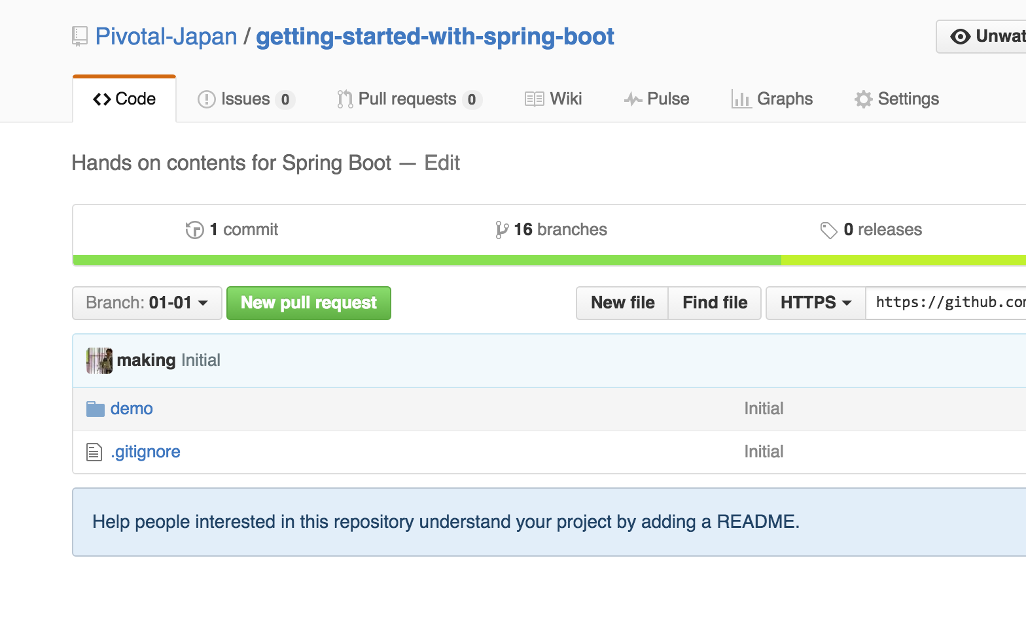
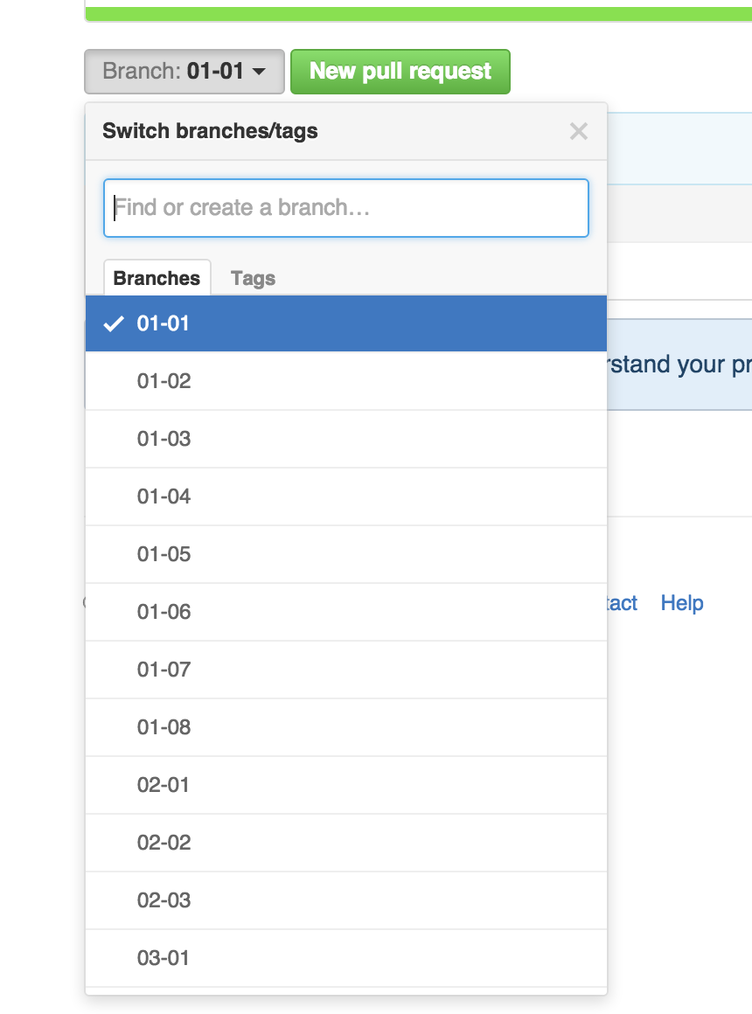
Source Code
https://github.com/Pivotal-Japan/getting-started-with-spring-boot

Slide 4
Spring Framework
Spring is a Java framework for enterprise applications, supports
dependency injection
transaction management
web applications
data access
messaging
testing and more.

Slide 5
Spring Boot
Spring Boot makes it easy to create stand-alone, production-grade Spring based Applications that you can "just run".

Slide 6
Spring Boot
Create stand-alone Spring applications
Embed Tomcat, Jetty or Undertow directly
Provide opinionated 'starter' POMs to simplify your Maven configuration
Automatically configure Spring whenever possible
Provide production-ready features such as metrics, health checks and externalized configuration
Absolutely no code generation and no requirement for XML configuration

Slide 7
Hello World

Slide 8
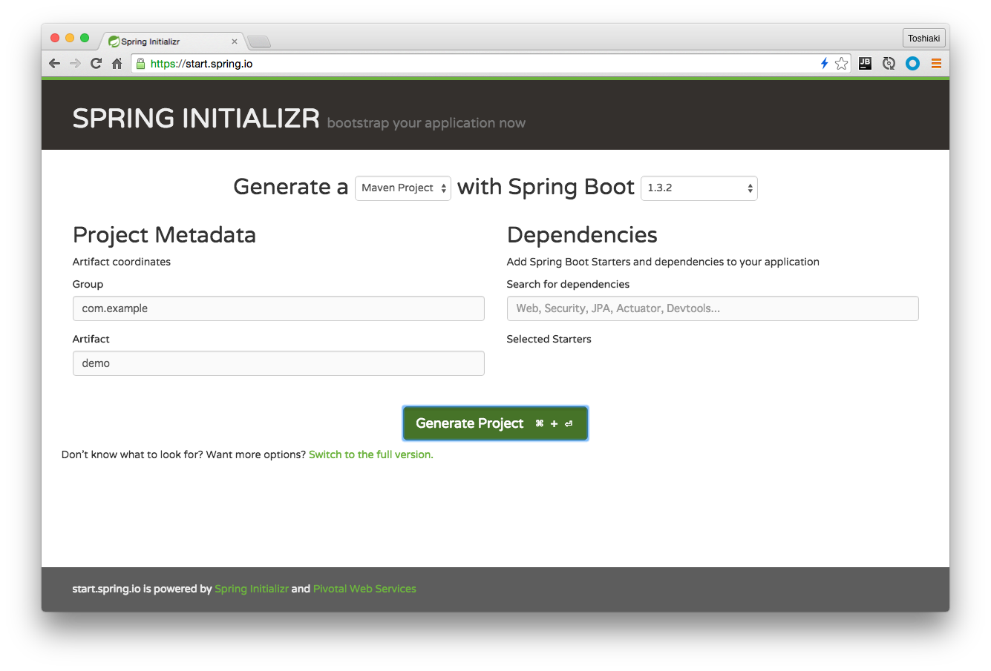
https://start.spring.io
Click

Slide 9
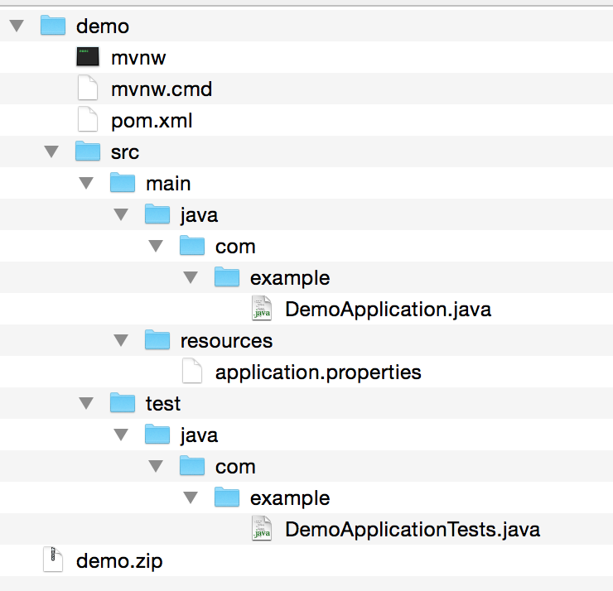

Slide 10
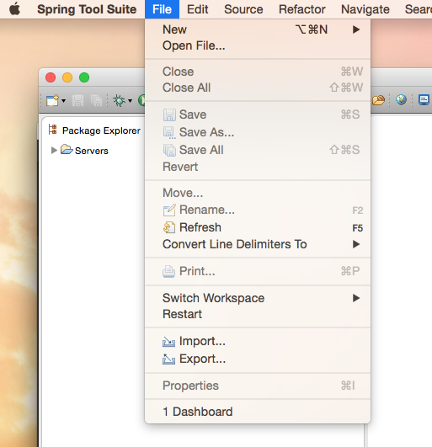

Slide 11
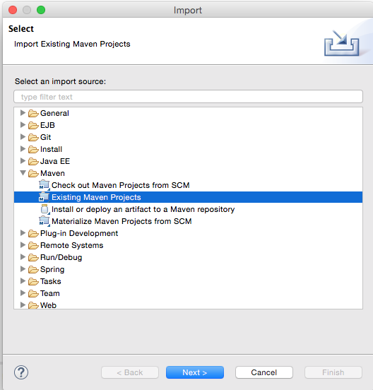

Slide 12
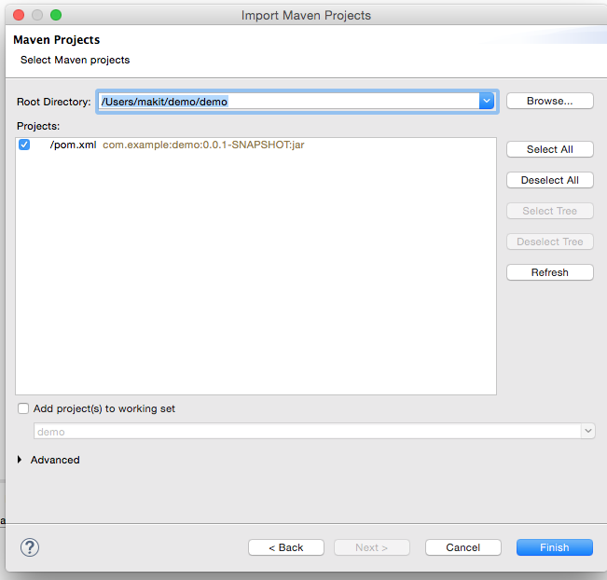

Slide 13
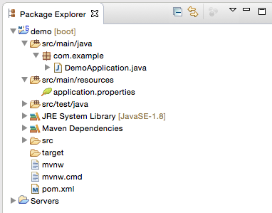

Slide 14
Boilerplate entry point
@SpringBootApplication public class DemoApplication { public static void main(String[] args) {
SpringApplication.run(DemoApplication.class,args); } }

Slide 15
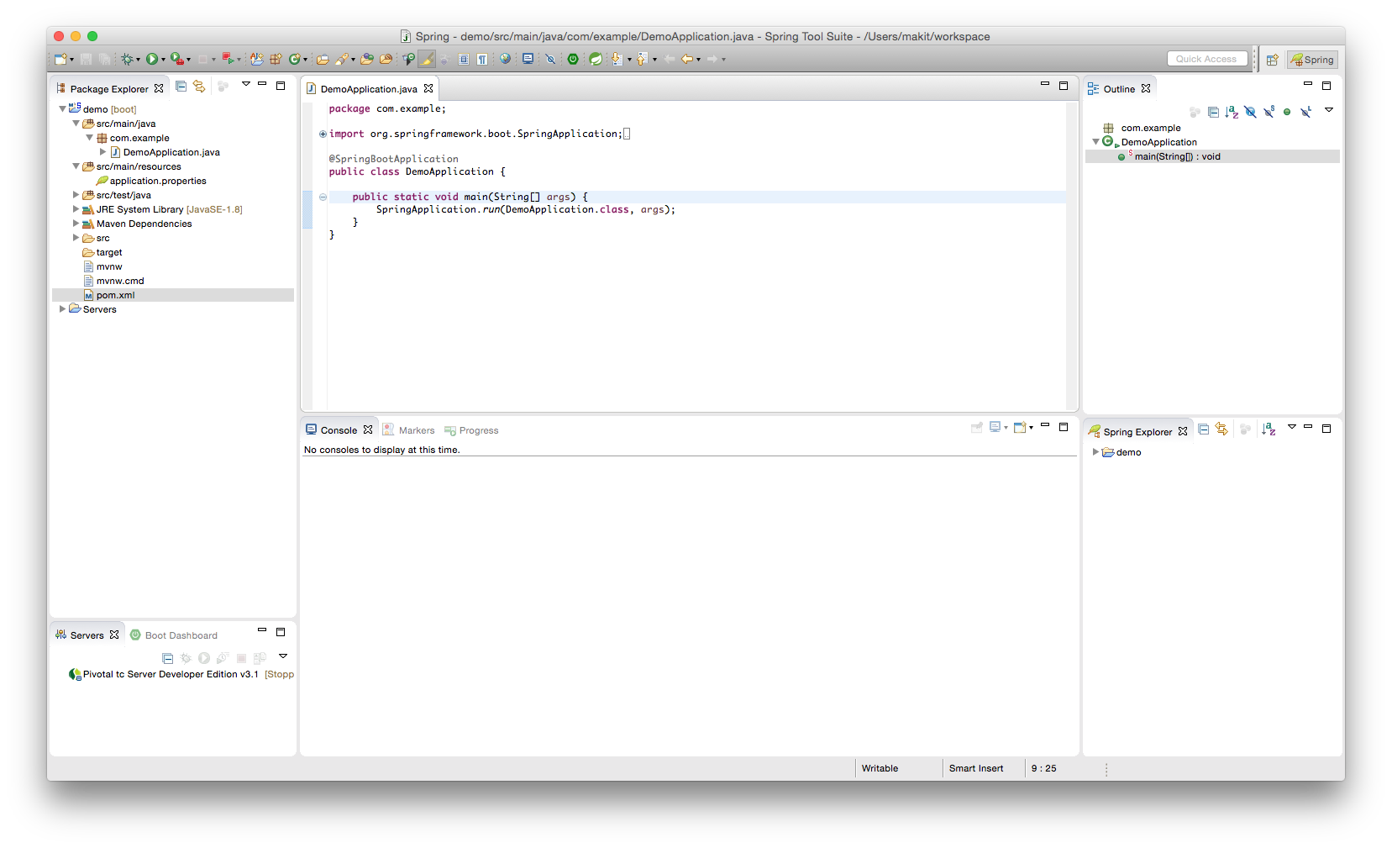
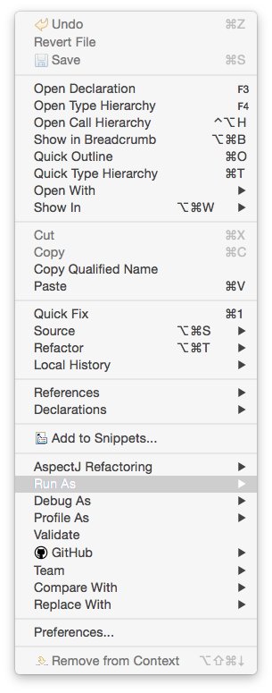
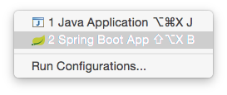

Slide 16
Output (01-01)
. ____ _ __ _ _
/\\ / ___'_ __ _ _(_)_ __ __ _ \ \ \ \
( ( )\___ | '_ | '_| | '_ \/ _` | \ \ \ \
\\/ ___)| |_)| | | | | || (_| | ) ) ) )
' |____| .__|_| |_|_| |_\__, | / / / /
=========|_|==============|___/=/_/_/_/
:: Spring Boot :: (v1.5.1.RELEASE)
2017-02-07 10:08:49.902 INFO 89397 --- [ main] com.example.DemoApplication : Starting DemoApplication on jpxxmakitm1.corp.emc.com with PID 89397 (/Users/makit/git/getting-started-with-spring-boot/demo/target/classes started by makit in /Users/makit/git/getting-started-with-spring-boot/demo)
2017-02-07 10:08:49.907 INFO 89397 --- [ main] com.example.DemoApplication : No active profile set, falling back to default profiles: default
2017-02-07 10:08:49.968 INFO 89397 --- [ main] s.c.a.AnnotationConfigApplicationContext : Refreshing org.springframework.context.annotation.AnnotationConfigApplicationContext@319b92f3: startup date [Tue Feb 07 10:08:49 JST 2017]; root of context hierarchy
2017-02-07 10:08:50.428 INFO 89397 --- [ main] o.s.j.e.a.AnnotationMBeanExporter : Registering beans for JMX exposure on startup
2017-02-07 10:08:50.440 INFO 89397 --- [ main] com.example.DemoApplication : Started DemoApplication in 0.762 seconds (JVM running for 1.055)
2017-02-07 10:08:50.441 INFO 89397 --- [ Thread-2] s.c.a.AnnotationConfigApplicationContext : Closing org.springframework.context.annotation.AnnotationConfigApplicationContext@319b92f3: startup date [Tue Feb 07 10:08:49 JST 2017]; root of context hierarchy
2017-02-07 10:08:50.442 INFO 89397 --- [ Thread-2] o.s.j.e.a.AnnotationMBeanExporter : Unregistering JMX-exposed beans on shutdown

Slide 17
Use CommandLineRunner
@SpringBootApplication public class DemoApplication implements CommandLineRunner { public static void main(String[] args) {
SpringApplication.run(DemoApplication.class,args); }
@Override
public void run(String... args) throws Exception {
System.out.println("Hello World!");
} }

Slide 18
Output (01-02)
. ____ _ __ _ _
/\\ / ___'_ __ _ _(_)_ __ __ _ \ \ \ \
( ( )\___ | '_ | '_| | '_ \/ _` | \ \ \ \
\\/ ___)| |_)| | | | | || (_| | ) ) ) )
' |____| .__|_| |_|_| |_\__, | / / / /
=========|_|==============|___/=/_/_/_/
:: Spring Boot :: (v1.5.1.RELEASE)
2017-02-07 10:12:24.618 INFO 90019 --- [ main] com.example.DemoApplication : Starting DemoApplication on jpxxmakitm1.corp.emc.com with PID 90019 (/Users/makit/git/getting-started-with-spring-boot/demo/target/classes started by makit in /Users/makit/git/getting-started-with-spring-boot/demo)
2017-02-07 10:12:24.621 INFO 90019 --- [ main] com.example.DemoApplication : No active profile set, falling back to default profiles: default
2017-02-07 10:12:24.673 INFO 90019 --- [ main] s.c.a.AnnotationConfigApplicationContext : Refreshing org.springframework.context.annotation.AnnotationConfigApplicationContext@27d415d9: startup date [Tue Feb 07 10:12:24 JST 2017]; root of context hierarchy
2017-02-07 10:12:25.117 INFO 90019 --- [ main] o.s.j.e.a.AnnotationMBeanExporter : Registering beans for JMX exposure on startup
Hello World!
2017-02-07 10:12:25.129 INFO 90019 --- [ main] com.example.DemoApplication : Started DemoApplication in 0.729 seconds (JVM running for 1.027)
2017-02-07 10:12:25.129 INFO 90019 --- [ Thread-2] s.c.a.AnnotationConfigApplicationContext : Closing org.springframework.context.annotation.AnnotationConfigApplicationContext@27d415d9: startup date [Tue Feb 07 10:12:24 JST 2017]; root of context hierarchy
2017-02-07 10:12:25.130 INFO 90019 --- [ Thread-2] o.s.j.e.a.AnnotationMBeanExporter : Unregistering JMX-exposed beans on shutdown

Slide 19
Make a first component
package com.example; public interface GreetingService { String greet(); }

Slide 20
Implement GreetingService
package com.example; public class SimpleGreetingService implements GreetingService {
@Override public String greet() {
return "Hello World!";
} }

Slide 21
Define a Bean
@SpringBootApplication public class DemoApplication implements CommandLineRunner {
@Bean
GreetingService greetingService() {
return new SimpleGreetingService();
}
public static void main(String[] args) {/* ommit */}
@Override
public void run(String... args) throws Exception {/* ommit */} }

Slide 22
Inject GreetingService & use this
@SpringBootApplication public class DemoApplication implements CommandLineRunner {
@Bean GreetingService greetingService() {/* ommit */}
@Autowired
GreetingService greetingService;
public static void main(String[] args) {/* ommit */}
@Override
public void run(String... args) throws Exception {
System.out.println(greetingService.greet());
} }

Slide 23
Output (01-03)
. ____ _ __ _ _
/\\ / ___'_ __ _ _(_)_ __ __ _ \ \ \ \
( ( )\___ | '_ | '_| | '_ \/ _` | \ \ \ \
\\/ ___)| |_)| | | | | || (_| | ) ) ) )
' |____| .__|_| |_|_| |_\__, | / / / /
=========|_|==============|___/=/_/_/_/
:: Spring Boot :: (v1.5.1.RELEASE)
2017-02-07 10:14:37.235 INFO 90402 --- [ main] com.example.DemoApplication : Starting DemoApplication on jpxxmakitm1.corp.emc.com with PID 90402 (/Users/makit/git/getting-started-with-spring-boot/demo/target/classes started by makit in /Users/makit/git/getting-started-with-spring-boot/demo)
2017-02-07 10:14:37.238 INFO 90402 --- [ main] com.example.DemoApplication : No active profile set, falling back to default profiles: default
2017-02-07 10:14:37.292 INFO 90402 --- [ main] s.c.a.AnnotationConfigApplicationContext : Refreshing org.springframework.context.annotation.AnnotationConfigApplicationContext@27d415d9: startup date [Tue Feb 07 10:14:37 JST 2017]; root of context hierarchy
2017-02-07 10:14:37.759 INFO 90402 --- [ main] o.s.j.e.a.AnnotationMBeanExporter : Registering beans for JMX exposure on startup
Hello World!
2017-02-07 10:14:37.771 INFO 90402 --- [ main] com.example.DemoApplication : Started DemoApplication in 0.752 seconds (JVM running for 1.054)
2017-02-07 10:14:37.772 INFO 90402 --- [ Thread-2] s.c.a.AnnotationConfigApplicationContext : Closing org.springframework.context.annotation.AnnotationConfigApplicationContext@27d415d9: startup date [Tue Feb 07 10:14:37 JST 2017]; root of context hierarchy
2017-02-07 10:14:37.773 INFO 90402 --- [ Thread-2] o.s.j.e.a.AnnotationMBeanExporter : Unregistering JMX-exposed beans on shutdown

Slide 24
Annotate with @Component
@Component public class SimpleGreetingService implements GreetingService {
@Override public String greet() {
return "Hello World!";
} }

Slide 25
Remove the Bean definition
@SpringBootApplication public class DemoApplication implements CommandLineRunner {
@Bean GreetingService greetingService() {/* ommit */}
@Autowired
GreetingService greetingService;
public static void main(String[] args) {/* ommit */}
@Override
public void run(String... args) throws Exception {
System.out.println(greetingService.greet());
} }
@Component public class SimpleGreetingService implements GreetingService {
@Override public String greet() {
return "Hello World!";
} }

Slide 26
Remove the Bean definition
@SpringBootApplication public class DemoApplication implements CommandLineRunner {
@Autowired
GreetingService greetingService;
public static void main(String[] args) {/* ommit */}
@Override
public void run(String... args) throws Exception {
System.out.println(greetingService.greet());
} }
@Component public class SimpleGreetingService implements GreetingService {
@Override public String greet() {
return "Hello World!";
} }

Slide 27
Output (01-04)
. ____ _ __ _ _
/\\ / ___'_ __ _ _(_)_ __ __ _ \ \ \ \
( ( )\___ | '_ | '_| | '_ \/ _` | \ \ \ \
\\/ ___)| |_)| | | | | || (_| | ) ) ) )
' |____| .__|_| |_|_| |_\__, | / / / /
=========|_|==============|___/=/_/_/_/
:: Spring Boot :: (v1.5.1.RELEASE)
2017-02-07 10:17:22.878 INFO 91014 --- [ main] com.example.DemoApplication : Starting DemoApplication on jpxxmakitm1.corp.emc.com with PID 91014 (/Users/makit/git/getting-started-with-spring-boot/demo/target/classes started by makit in /Users/makit/git/getting-started-with-spring-boot/demo)
2017-02-07 10:17:22.883 INFO 91014 --- [ main] com.example.DemoApplication : No active profile set, falling back to default profiles: default
2017-02-07 10:17:22.939 INFO 91014 --- [ main] s.c.a.AnnotationConfigApplicationContext : Refreshing org.springframework.context.annotation.AnnotationConfigApplicationContext@27d415d9: startup date [Tue Feb 07 10:17:22 JST 2017]; root of context hierarchy
2017-02-07 10:17:23.479 INFO 91014 --- [ main] o.s.j.e.a.AnnotationMBeanExporter : Registering beans for JMX exposure on startup
Hello World!
2017-02-07 10:17:23.509 INFO 91014 --- [ main] com.example.DemoApplication : Started DemoApplication in 0.858 seconds (JVM running for 1.158)
2017-02-07 10:17:23.510 INFO 91014 --- [ Thread-2] s.c.a.AnnotationConfigApplicationContext : Closing org.springframework.context.annotation.AnnotationConfigApplicationContext@27d415d9: startup date [Tue Feb 07 10:17:22 JST 2017]; root of context hierarchy
2017-02-07 10:17:23.513 INFO 91014 --- [ Thread-2] o.s.j.e.a.AnnotationMBeanExporter : Unregistering JMX-exposed beans on shutdown

Slide 28
Make another GreetingService
@Component public class PropertyGreetingService implements GreetingService {
@Value("${greeting.message}")
String message;
@Override public String greet() {
return message;
} }

Slide 29
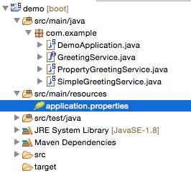
Configure the property

Slide 30
Make another GreetingService
greeting.message=Hello New World!

Slide 31
Remove @Component from Simple
@Component public class SimpleGreetingService implements GreetingService {
@Override public String greet() {
return "Hello World!";
} }

Slide 32
Remove @Component from Simple
public class SimpleGreetingService implements GreetingService {
@Override public String greet() {
return "Hello World!";
} }

Slide 33
Output (01-05)
. ____ _ __ _ _
/\\ / ___'_ __ _ _(_)_ __ __ _ \ \ \ \
( ( )\___ | '_ | '_| | '_ \/ _` | \ \ \ \
\\/ ___)| |_)| | | | | || (_| | ) ) ) )
' |____| .__|_| |_|_| |_\__, | / / / /
=========|_|==============|___/=/_/_/_/
:: Spring Boot :: (v1.5.1.RELEASE)
2017-02-07 10:19:27.078 INFO 91368 --- [ main] com.example.DemoApplication : Starting DemoApplication on jpxxmakitm1.corp.emc.com with PID 91368 (/Users/makit/git/getting-started-with-spring-boot/demo/target/classes started by makit in /Users/makit/git/getting-started-with-spring-boot/demo)
2017-02-07 10:19:27.081 INFO 91368 --- [ main] com.example.DemoApplication : No active profile set, falling back to default profiles: default
2017-02-07 10:19:27.135 INFO 91368 --- [ main] s.c.a.AnnotationConfigApplicationContext : Refreshing org.springframework.context.annotation.AnnotationConfigApplicationContext@17211155: startup date [Tue Feb 07 10:19:27 JST 2017]; root of context hierarchy
2017-02-07 10:19:27.591 INFO 91368 --- [ main] o.s.j.e.a.AnnotationMBeanExporter : Registering beans for JMX exposure on startup
Hello New World!
2017-02-07 10:19:27.603 INFO 91368 --- [ main] com.example.DemoApplication : Started DemoApplication in 0.749 seconds (JVM running for 1.044)
2017-02-07 10:19:27.604 INFO 91368 --- [ Thread-2] s.c.a.AnnotationConfigApplicationContext : Closing org.springframework.context.annotation.AnnotationConfigApplicationContext@17211155: startup date [Tue Feb 07 10:19:27 JST 2017]; root of context hierarchy
2017-02-07 10:19:27.605 INFO 91368 --- [ Thread-2] o.s.j.e.a.AnnotationMBeanExporter : Unregistering JMX-exposed beans on shutdown

Slide 34
What happen unless removing
@Component // <---- public class SimpleGreetingService implements GreetingService {
@Override public String greet() {
return "Hello World!";
} }

Slide 35
Output
Error starting ApplicationContext. To display the auto-configuration report re-run your application with 'debug' enabled.
2017-02-07 10:20:48.221 ERROR 91576 --- [ main] o.s.b.d.LoggingFailureAnalysisReporter :
***************************
APPLICATION FAILED TO START
***************************
Description:
Field greetingService in com.example.DemoApplication required a single bean, but 2 were found:
- propertyGreetingService: defined in file [/Users/makit/git/getting-started-with-spring-boot/demo/target/classes/com/example/PropertyGreetingService.class]
- simpleGreetingService: defined in file [/Users/makit/git/getting-started-with-spring-boot/demo/target/classes/com/example/SimpleGreetingService.class]
Action:
Consider marking one of the beans as @Primary, updating the consumer to accept multiple beans, or using @Qualifier to identify the bean that should be consumed

Slide 36
Solutions
Specify the Bean name explicitly with @Qualifier + @Autowired
Remove @Component from both and specify the concrete bean with @Bean
Annotate @Primary on preferred one

Slide 37
Solution 1
@SpringBootApplication public class DemoApplication implements CommandLineRunner {
@Autowired
@Qualifier("propertyGreetingService") // or simpleGreeting...
GreetingService greetingService;
public static void main(String[] args) {/* ommit */}
@Override
public void run(String... args) throws Exception {
System.out.println(greetingService.greet());
} }

Slide 38
Output (01-06)
. ____ _ __ _ _
/\\ / ___'_ __ _ _(_)_ __ __ _ \ \ \ \
( ( )\___ | '_ | '_| | '_ \/ _` | \ \ \ \
\\/ ___)| |_)| | | | | || (_| | ) ) ) )
' |____| .__|_| |_|_| |_\__, | / / / /
=========|_|==============|___/=/_/_/_/
:: Spring Boot :: (v1.5.1.RELEASE)
2017-02-07 10:25:51.394 INFO 92482 --- [ main] com.example.DemoApplication : Starting DemoApplication on jpxxmakitm1.corp.emc.com with PID 92482 (/Users/makit/git/getting-started-with-spring-boot/demo/target/classes started by makit in /Users/makit/git/getting-started-with-spring-boot/demo)
2017-02-07 10:25:51.398 INFO 92482 --- [ main] com.example.DemoApplication : No active profile set, falling back to default profiles: default
2017-02-07 10:25:51.446 INFO 92482 --- [ main] s.c.a.AnnotationConfigApplicationContext : Refreshing org.springframework.context.annotation.AnnotationConfigApplicationContext@17211155: startup date [Tue Feb 07 10:25:51 JST 2017]; root of context hierarchy
2017-02-07 10:25:51.896 INFO 92482 --- [ main] o.s.j.e.a.AnnotationMBeanExporter : Registering beans for JMX exposure on startup
Hello New World!
2017-02-07 10:25:51.908 INFO 92482 --- [ main] com.example.DemoApplication : Started DemoApplication in 0.742 seconds (JVM running for 1.026)
2017-02-07 10:25:51.909 INFO 92482 --- [ Thread-2] s.c.a.AnnotationConfigApplicationContext : Closing org.springframework.context.annotation.AnnotationConfigApplicationContext@17211155: startup date [Tue Feb 07 10:25:51 JST 2017]; root of context hierarchy
2017-02-07 10:25:51.910 INFO 92482 --- [ Thread-2] o.s.j.e.a.AnnotationMBeanExporter : Unregistering JMX-exposed beans on shutdown

Slide 39
Solution 2
@SpringBootApplication public class DemoApplication implements CommandLineRunner {
@Bean // remove @Component from both GreetingService
GreetingService greetingService() {
return new PropertyGreetingService();
}
public static void main(String[] args) {/* ommit */}
@Override
public void run(String... args) throws Exception {/* ommit */} }

Slide 40
Output (01-07)
. ____ _ __ _ _
/\\ / ___'_ __ _ _(_)_ __ __ _ \ \ \ \
( ( )\___ | '_ | '_| | '_ \/ _` | \ \ \ \
\\/ ___)| |_)| | | | | || (_| | ) ) ) )
' |____| .__|_| |_|_| |_\__, | / / / /
=========|_|==============|___/=/_/_/_/
:: Spring Boot :: (v1.5.1.RELEASE)
2017-02-07 10:31:10.260 INFO 93387 --- [ main] com.example.DemoApplication : Starting DemoApplication on jpxxmakitm1.corp.emc.com with PID 93387 (/Users/makit/git/getting-started-with-spring-boot/demo/target/classes started by makit in /Users/makit/git/getting-started-with-spring-boot/demo)
2017-02-07 10:31:10.264 INFO 93387 --- [ main] com.example.DemoApplication : No active profile set, falling back to default profiles: default
2017-02-07 10:31:10.314 INFO 93387 --- [ main] s.c.a.AnnotationConfigApplicationContext : Refreshing org.springframework.context.annotation.AnnotationConfigApplicationContext@17211155: startup date [Tue Feb 07 10:31:10 JST 2017]; root of context hierarchy
2017-02-07 10:31:10.796 INFO 93387 --- [ main] o.s.j.e.a.AnnotationMBeanExporter : Registering beans for JMX exposure on startup
Hello New World!
2017-02-07 10:31:10.809 INFO 93387 --- [ main] com.example.DemoApplication : Started DemoApplication in 0.769 seconds (JVM running for 1.055)
2017-02-07 10:31:10.810 INFO 93387 --- [ Thread-2] s.c.a.AnnotationConfigApplicationContext : Closing org.springframework.context.annotation.AnnotationConfigApplicationContext@17211155: startup date [Tue Feb 07 10:31:10 JST 2017]; root of context hierarchy
2017-02-07 10:31:10.811 INFO 93387 --- [ Thread-2] o.s.j.e.a.AnnotationMBeanExporter : Unregistering JMX-exposed beans on shutdown

Slide 41
Solution 3
@Component
@Primary public class PropertyGreetingService implements GreetingService {
@Value("${greeting.message}")
String message;
@Override public String greet() {
return message;
} }

Slide 42
Output (01-08)
. ____ _ __ _ _
/\\ / ___'_ __ _ _(_)_ __ __ _ \ \ \ \
( ( )\___ | '_ | '_| | '_ \/ _` | \ \ \ \
\\/ ___)| |_)| | | | | || (_| | ) ) ) )
' |____| .__|_| |_|_| |_\__, | / / / /
=========|_|==============|___/=/_/_/_/
:: Spring Boot :: (v1.5.1.RELEASE)
2017-02-07 10:33:09.088 INFO 93715 --- [ main] com.example.DemoApplication : Starting DemoApplication on jpxxmakitm1.corp.emc.com with PID 93715 (/Users/makit/git/getting-started-with-spring-boot/demo/target/classes started by makit in /Users/makit/git/getting-started-with-spring-boot/demo)
2017-02-07 10:33:09.091 INFO 93715 --- [ main] com.example.DemoApplication : No active profile set, falling back to default profiles: default
2017-02-07 10:33:09.141 INFO 93715 --- [ main] s.c.a.AnnotationConfigApplicationContext : Refreshing org.springframework.context.annotation.AnnotationConfigApplicationContext@17211155: startup date [Tue Feb 07 10:33:09 JST 2017]; root of context hierarchy
2017-02-07 10:33:09.600 INFO 93715 --- [ main] o.s.j.e.a.AnnotationMBeanExporter : Registering beans for JMX exposure on startup
Hello New World!
2017-02-07 10:33:09.612 INFO 93715 --- [ main] com.example.DemoApplication : Started DemoApplication in 0.748 seconds (JVM running for 1.039)
2017-02-07 10:33:09.613 INFO 93715 --- [ Thread-2] s.c.a.AnnotationConfigApplicationContext : Closing org.springframework.context.annotation.AnnotationConfigApplicationContext@17211155: startup date [Tue Feb 07 10:33:09 JST 2017]; root of context hierarchy
2017-02-07 10:33:09.614 INFO 93715 --- [ Thread-2] o.s.j.e.a.AnnotationMBeanExporter : Unregistering JMX-exposed beans on shutdown

Slide 43
Solution 4
@Component
@Vanilla public class SimpleGreetingService implements GreetingService {/*...*/}
@SpringBootApplication public class DemoApplication
implements CommandLineRunner {
@Autowired @Vanilla
GreetingService greetingService;
}

Slide 44
Solution 4
package com.example; import org.springframework.beans.factory.annotation.Qualifier; import java.lang.annotation.*;
@Target({ElementType.FIELD, ElementType.METHOD,
ElementType.TYPE}) @Retention(RetentionPolicy.RUNTIME) @Inherited @Documented @Qualifier public @interface Vanilla { }

Slide 45
Build the application
$ cd demo
$ ./mvnw clean package -Dmaven.test.skip=true
$ java -jar target/demo-0.0.1-SNAPSHOT.jar

Slide 46
Change the property
$ java -jar target/demo-0.0.1-SNAPSHOT.jar --greeting.message=Hi
. ____ _ __ _ _
/\\ / ___'_ __ _ _(_)_ __ __ _ \ \ \ \
( ( )\___ | '_ | '_| | '_ \/ _` | \ \ \ \
\\/ ___)| |_)| | | | | || (_| | ) ) ) )
' |____| .__|_| |_|_| |_\__, | / / / /
=========|_|==============|___/=/_/_/_/
:: Spring Boot :: (v1.5.1.RELEASE)
2017-02-07 10:35:02.415 INFO 94047 --- [ main] com.example.DemoApplication : Starting DemoApplication v0.0.1-SNAPSHOT on jpxxmakitm1.corp.emc.com with PID 94047 (/Users/makit/git/getting-started-with-spring-boot/demo/target/demo-0.0.1-SNAPSHOT.jar started by makit in /Users/makit/git/getting-started-with-spring-boot/demo)
2017-02-07 10:35:02.419 INFO 94047 --- [ main] com.example.DemoApplication : No active profile set, falling back to default profiles: default
2017-02-07 10:35:02.479 INFO 94047 --- [ main] s.c.a.AnnotationConfigApplicationContext : Refreshing org.springframework.context.annotation.AnnotationConfigApplicationContext@5b37e0d2: startup date [Tue Feb 07 10:35:02 JST 2017]; root of context hierarchy
2017-02-07 10:35:02.985 INFO 94047 --- [ main] o.s.j.e.a.AnnotationMBeanExporter : Registering beans for JMX exposure on startup
Hi
2017-02-07 10:35:02.998 INFO 94047 --- [ main] com.example.DemoApplication : Started DemoApplication in 0.901 seconds (JVM running for 1.271)
2017-02-07 10:35:02.999 INFO 94047 --- [ Thread-2] s.c.a.AnnotationConfigApplicationContext : Closing org.springframework.context.annotation.AnnotationConfigApplicationContext@5b37e0d2: startup date [Tue Feb 07 10:35:02 JST 2017]; root of context hierarchy
2017-02-07 10:35:03.001 INFO 94047 --- [ Thread-2] o.s.j.e.a.AnnotationMBeanExporter : Unregistering JMX-exposed beans on shutdown

Slide 47
Web Application

Slide 48
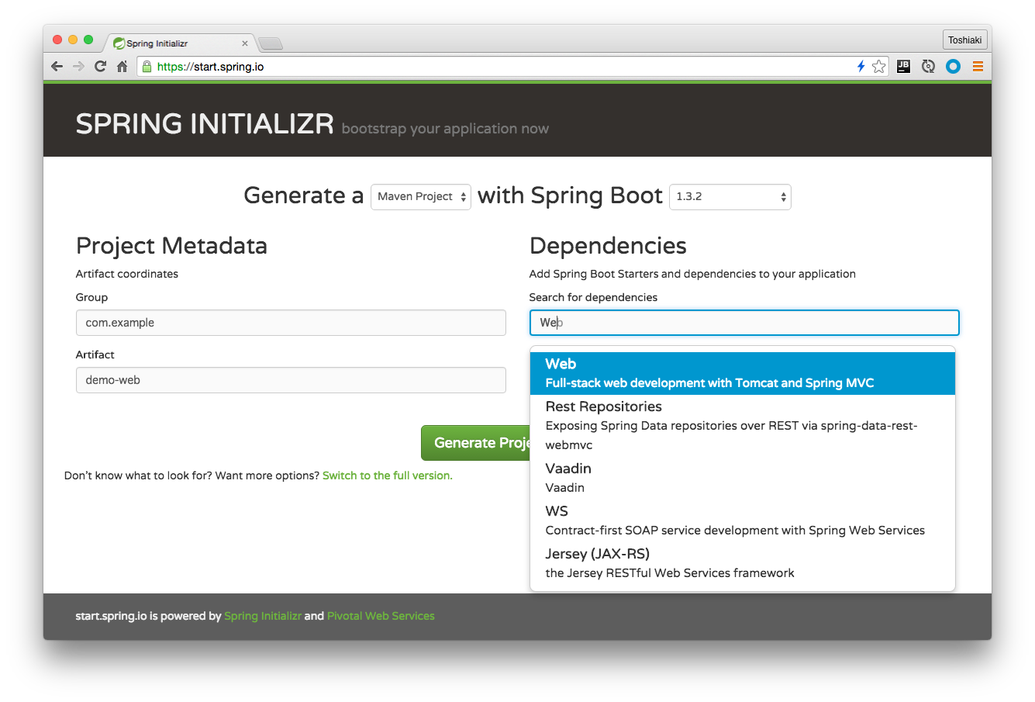

Slide 51
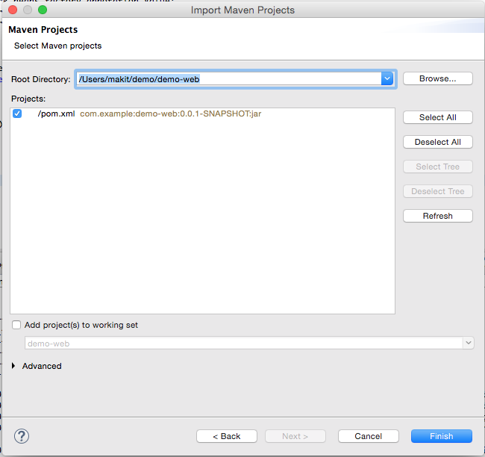

Slide 52
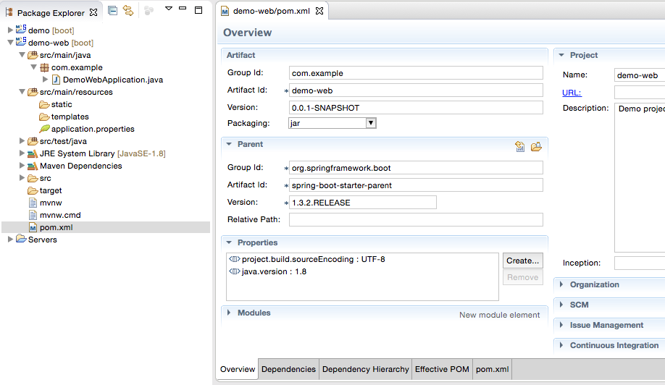

Slide 53
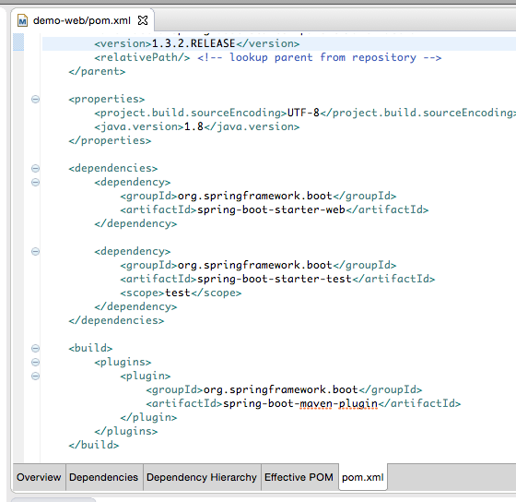
Added

Slide 54
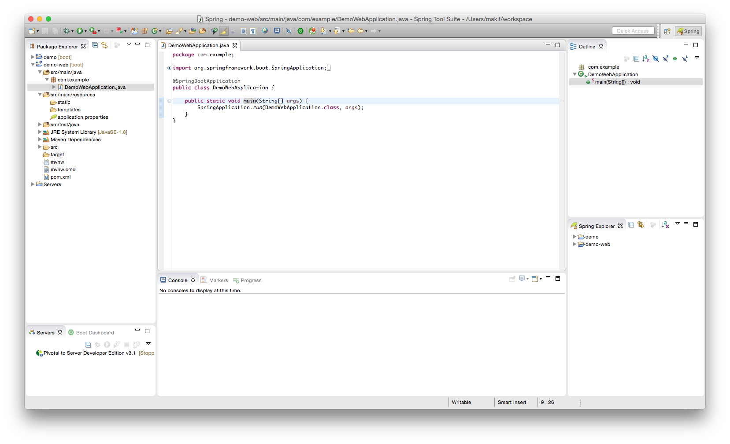

Slide 55
Output (02-01)
. ____ _ __ _ _
/\\ / ___'_ __ _ _(_)_ __ __ _ \ \ \ \
( ( )\___ | '_ | '_| | '_ \/ _` | \ \ \ \
\\/ ___)| |_)| | | | | || (_| | ) ) ) )
' |____| .__|_| |_|_| |_\__, | / / / /
=========|_|==============|___/=/_/_/_/
:: Spring Boot :: (v1.5.1.RELEASE)
2017-02-07 10:41:20.740 INFO 95220 --- [ main] com.example.DemoWebApplication : Starting DemoWebApplication on jpxxmakitm1.corp.emc.com with PID 95220 (/Users/makit/git/getting-started-with-spring-boot/demo-web/target/classes started by makit in /Users/makit/git/getting-started-with-spring-boot/demo-web)
2017-02-07 10:41:20.743 INFO 95220 --- [ main] com.example.DemoWebApplication : No active profile set, falling back to default profiles: default
2017-02-07 10:41:20.810 INFO 95220 --- [ main] ationConfigEmbeddedWebApplicationContext : Refreshing org.springframework.boot.context.embedded.AnnotationConfigEmbeddedWebApplicationContext@4b9e255: startup date [Tue Feb 07 10:41:20 JST 2017]; root of context hierarchy
2017-02-07 10:41:21.488 INFO 95220 --- [ main] trationDelegate$BeanPostProcessorChecker : Bean 'org.springframework.boot.autoconfigure.validation.ValidationAutoConfiguration' of type [class org.springframework.boot.autoconfigure.validation.ValidationAutoConfiguration] is not eligible for getting processed by all BeanPostProcessors (for example: not eligible for auto-proxying)
2017-02-07 10:41:21.545 INFO 95220 --- [ main] trationDelegate$BeanPostProcessorChecker : Bean 'validator' of type [class org.springframework.validation.beanvalidation.LocalValidatorFactoryBean] is not eligible for getting processed by all BeanPostProcessors (for example: not eligible for auto-proxying)
2017-02-07 10:41:21.778 INFO 95220 --- [ main] s.b.c.e.t.TomcatEmbeddedServletContainer : Tomcat initialized with port(s): 8080 (http)
2017-02-07 10:41:21.793 INFO 95220 --- [ main] o.apache.catalina.core.StandardService : Starting service Tomcat

Slide 56
First Controller
@SpringBootApplication
@RestController public class DemoApplication {
@GetMapping("/")
String hello() {
return "Hello World!";
}
public static void main(String[] args) {
SpringApplication.run(DemoApplication.class,args); } }

Slide 57
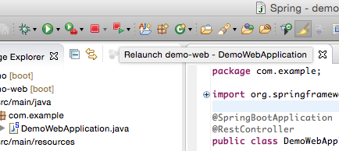

Slide 58
Output (02-02)
. ____ _ __ _ _
/\\ / ___'_ __ _ _(_)_ __ __ _ \ \ \ \
( ( )\___ | '_ | '_| | '_ \/ _` | \ \ \ \
\\/ ___)| |_)| | | | | || (_| | ) ) ) )
' |____| .__|_| |_|_| |_\__, | / / / /
=========|_|==============|___/=/_/_/_/
:: Spring Boot :: (v1.5.1.RELEASE)
2017-02-07 10:45:57.323 INFO 96035 --- [ main] com.example.DemoWebApplication : Starting DemoWebApplication on jpxxmakitm1.corp.emc.com with PID 96035 (/Users/makit/git/getting-started-with-spring-boot/demo-web/target/classes started by makit in /Users/makit/git/getting-started-with-spring-boot/demo-web)
2017-02-07 10:45:57.327 INFO 96035 --- [ main] com.example.DemoWebApplication : No active profile set, falling back to default profiles: default
2017-02-07 10:45:57.392 INFO 96035 --- [ main] ationConfigEmbeddedWebApplicationContext : Refreshing org.springframework.boot.context.embedded.AnnotationConfigEmbeddedWebApplicationContext@4b9e255: startup date [Tue Feb 07 10:45:57 JST 2017]; root of context hierarchy
2017-02-07 10:45:58.078 INFO 96035 --- [ main] trationDelegate$BeanPostProcessorChecker : Bean 'org.springframework.boot.autoconfigure.validation.ValidationAutoConfiguration' of type [class org.springframework.boot.autoconfigure.validation.ValidationAutoConfiguration] is not eligible for getting processed by all BeanPostProcessors (for example: not eligible for auto-proxying)
2017-02-07 10:45:58.139 INFO 96035 --- [ main] trationDelegate$BeanPostProcessorChecker : Bean 'validator' of type [class org.springframework.validation.beanvalidation.LocalValidatorFactoryBean] is not eligible for getting processed by all BeanPostProcessors (for example: not eligible for auto-proxying)
2017-02-07 10:45:58.376 INFO 96035 --- [ main] s.b.c.e.t.TomcatEmbeddedServletContainer : Tomcat initialized with port(s): 8080 (http)
2017-02-07 10:45:58.392 INFO 96035 --- [ main] o.apache.catalina.core.StandardService : Starting service Tomcat
2017-02-07 10:45:58.393 INFO 96035 --- [ main] org.apache.catalina.core.StandardEngine : Starting Servlet Engine: Apache Tomcat/8.5.11
2017-02-07 10:45:58.487 INFO 96035 --- [ost-startStop-1] o.a.c.c.C.[Tomcat].[localhost].[/] : Initializing Spring embedded WebApplicationContext
2017-02-07 10:45:58.487 INFO 96035 --- [ost-startStop-1] o.s.web.context.ContextLoader : Root WebApplicationContext: initialization completed in 1099 ms
2017-02-07 10:45:58.603 INFO 96035 --- [ost-startStop-1] o.s.b.w.servlet.ServletRegistrationBean : Mapping servlet: 'dispatcherServlet' to [/]
2017-02-07 10:45:58.607 INFO 96035 --- [ost-startStop-1] o.s.b.w.servlet.FilterRegistrationBean : Mapping filter: 'characterEncodingFilter' to: [/*]
2017-02-07 10:45:58.607 INFO 96035 --- [ost-startStop-1] o.s.b.w.servlet.FilterRegistrationBean : Mapping filter: 'hiddenHttpMethodFilter' to: [/*]
2017-02-07 10:45:58.607 INFO 96035 --- [ost-startStop-1] o.s.b.w.servlet.FilterRegistrationBean : Mapping filter: 'httpPutFormContentFilter' to: [/*]
2017-02-07 10:45:58.607 INFO 96035 --- [ost-startStop-1] o.s.b.w.servlet.FilterRegistrationBean : Mapping filter: 'requestContextFilter' to: [/*]
2017-02-07 10:45:58.859 INFO 96035 --- [ main] s.w.s.m.m.a.RequestMappingHandlerAdapter : Looking for @ControllerAdvice: org.springframework.boot.context.embedded.AnnotationConfigEmbeddedWebApplicationContext@4b9e255: startup date [Tue Feb 07 10:45:57 JST 2017]; root of context hierarchy
2017-02-07 10:45:58.926 INFO 96035 --- [ main] s.w.s.m.m.a.RequestMappingHandlerMapping : Mapped "{[/],methods=[GET]}" onto java.lang.String com.example.DemoWebApplication.hello()
2017-02-07 10:45:58.931 INFO 96035 --- [ main] s.w.s.m.m.a.RequestMappingHandlerMapping : Mapped "{[/error]}" onto public org.springframework.http.ResponseEntity<java.util.Map<java.lang.String, java.lang.Object>> org.springframework.boot.autoconfigure.web.BasicErrorController.error(javax.servlet.http.HttpServletRequest)
2017-02-07 10:45:58.931 INFO 96035 --- [ main] s.w.s.m.m.a.RequestMappingHandlerMapping : Mapped "{[/error],produces=[text/html]}" onto public org.springframework.web.servlet.ModelAndView org.springframework.boot.autoconfigure.web.BasicErrorController.errorHtml(javax.servlet.http.HttpServletRequest,javax.servlet.http.HttpServletResponse)
2017-02-07 10:45:58.962 INFO 96035 --- [ main] o.s.w.s.handler.SimpleUrlHandlerMapping : Mapped URL path [/webjars/**] onto handler of type [class org.springframework.web.servlet.resource.ResourceHttpRequestHandler]
2017-02-07 10:45:58.962 INFO 96035 --- [ main] o.s.w.s.handler.SimpleUrlHandlerMapping : Mapped URL path [/**] onto handler of type [class org.springframework.web.servlet.resource.ResourceHttpRequestHandler]
2017-02-07 10:45:59.049 INFO 96035 --- [ main] o.s.w.s.handler.SimpleUrlHandlerMapping : Mapped URL path [/**/favicon.ico] onto handler of type [class org.springframework.web.servlet.resource.ResourceHttpRequestHandler]
2017-02-07 10:45:59.243 INFO 96035 --- [ main] o.s.j.e.a.AnnotationMBeanExporter : Registering beans for JMX exposure on startup
2017-02-07 10:45:59.310 INFO 96035 --- [ main] s.b.c.e.t.TomcatEmbeddedServletContainer : Tomcat started on port(s): 8080 (http)
2017-02-07 10:45:59.314 INFO 96035 --- [ main] com.example.DemoWebApplication : Started DemoWebApplication in 2.242 seconds (JVM running for 2.583)

Slide 59
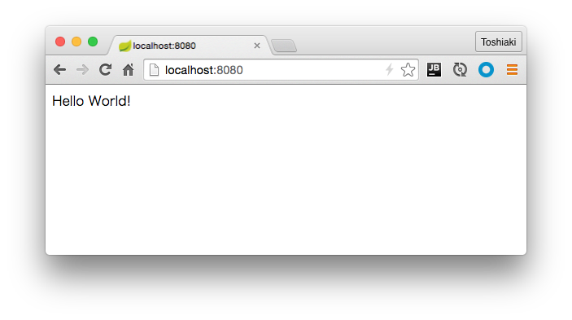
http://localhost:8080

Slide 60
Create new Controller (REST API)
package com.example;
public class City {
private Integer id;
private String name;
public Integer getId() {
return id;
}
public void setId(Integer id) {
this.id = id;
}
public String getName() {
return name;
}
public void setName(String name) {
this.name = name;
}
}

Slide 61
Create new Controller (REST API)
@RestController
public class CityController {
static List<City> cities = new CopyOnWriteArrayList<>();
static AtomicInteger counter = new AtomicInteger(0);
@GetMapping("/cities")
List<City> getCities() {
return cities;
}
@PostMapping("/cities")
City postCities(@RequestBody City city) {
city.setId(counter.incrementAndGet());
cities.add(city);
return city;
}
}

Slide 62
Output (02-03)
. ____ _ __ _ _
/\\ / ___'_ __ _ _(_)_ __ __ _ \ \ \ \
( ( )\___ | '_ | '_| | '_ \/ _` | \ \ \ \
\\/ ___)| |_)| | | | | || (_| | ) ) ) )
' |____| .__|_| |_|_| |_\__, | / / / /
=========|_|==============|___/=/_/_/_/
:: Spring Boot :: (v1.5.1.RELEASE)
2017-02-07 10:58:29.389 INFO 99327 --- [ main] com.example.DemoWebApplication : Starting DemoWebApplication on jpxxmakitm1.corp.emc.com with PID 99327 (/Users/makit/git/getting-started-with-spring-boot/demo-web/target/classes started by makit in /Users/makit/git/getting-started-with-spring-boot/demo-web)
2017-02-07 10:58:29.391 INFO 99327 --- [ main] com.example.DemoWebApplication : No active profile set, falling back to default profiles: default
2017-02-07 10:58:29.456 INFO 99327 --- [ main] ationConfigEmbeddedWebApplicationContext : Refreshing org.springframework.boot.context.embedded.AnnotationConfigEmbeddedWebApplicationContext@4b9e255: startup date [Tue Feb 07 10:58:29 JST 2017]; root of context hierarchy
2017-02-07 10:58:30.167 INFO 99327 --- [ main] trationDelegate$BeanPostProcessorChecker : Bean 'org.springframework.boot.autoconfigure.validation.ValidationAutoConfiguration' of type [class org.springframework.boot.autoconfigure.validation.ValidationAutoConfiguration] is not eligible for getting processed by all BeanPostProcessors (for example: not eligible for auto-proxying)
2017-02-07 10:58:30.230 INFO 99327 --- [ main] trationDelegate$BeanPostProcessorChecker : Bean 'validator' of type [class org.springframework.validation.beanvalidation.LocalValidatorFactoryBean] is not eligible for getting processed by all BeanPostProcessors (for example: not eligible for auto-proxying)
2017-02-07 10:58:30.464 INFO 99327 --- [ main] s.b.c.e.t.TomcatEmbeddedServletContainer : Tomcat initialized with port(s): 8080 (http)
2017-02-07 10:58:30.478 INFO 99327 --- [ main] o.apache.catalina.core.StandardService : Starting service Tomcat
2017-02-07 10:58:30.479 INFO 99327 --- [ main] org.apache.catalina.core.StandardEngine : Starting Servlet Engine: Apache Tomcat/8.5.11
2017-02-07 10:58:30.564 INFO 99327 --- [ost-startStop-1] o.a.c.c.C.[Tomcat].[localhost].[/] : Initializing Spring embedded WebApplicationContext
2017-02-07 10:58:30.564 INFO 99327 --- [ost-startStop-1] o.s.web.context.ContextLoader : Root WebApplicationContext: initialization completed in 1113 ms
2017-02-07 10:58:30.691 INFO 99327 --- [ost-startStop-1] o.s.b.w.servlet.ServletRegistrationBean : Mapping servlet: 'dispatcherServlet' to [/]
2017-02-07 10:58:30.696 INFO 99327 --- [ost-startStop-1] o.s.b.w.servlet.FilterRegistrationBean : Mapping filter: 'characterEncodingFilter' to: [/*]
2017-02-07 10:58:30.697 INFO 99327 --- [ost-startStop-1] o.s.b.w.servlet.FilterRegistrationBean : Mapping filter: 'hiddenHttpMethodFilter' to: [/*]
2017-02-07 10:58:30.697 INFO 99327 --- [ost-startStop-1] o.s.b.w.servlet.FilterRegistrationBean : Mapping filter: 'httpPutFormContentFilter' to: [/*]
2017-02-07 10:58:30.697 INFO 99327 --- [ost-startStop-1] o.s.b.w.servlet.FilterRegistrationBean : Mapping filter: 'requestContextFilter' to: [/*]
2017-02-07 10:58:30.990 INFO 99327 --- [ main] s.w.s.m.m.a.RequestMappingHandlerAdapter : Looking for @ControllerAdvice: org.springframework.boot.context.embedded.AnnotationConfigEmbeddedWebApplicationContext@4b9e255: startup date [Tue Feb 07 10:58:29 JST 2017]; root of context hierarchy
2017-02-07 10:58:31.064 INFO 99327 --- [ main] s.w.s.m.m.a.RequestMappingHandlerMapping : Mapped "{[/],methods=[GET]}" onto java.lang.String com.example.DemoWebApplication.hello()
2017-02-07 10:58:31.067 INFO 99327 --- [ main] s.w.s.m.m.a.RequestMappingHandlerMapping : Mapped "{[/cities],methods=[GET]}" onto java.util.List<com.example.City> com.example.CityController.getCities()
2017-02-07 10:58:31.067 INFO 99327 --- [ main] s.w.s.m.m.a.RequestMappingHandlerMapping : Mapped "{[/cities],methods=[POST]}" onto com.example.City com.example.CityController.postCities(com.example.City)
2017-02-07 10:58:31.070 INFO 99327 --- [ main] s.w.s.m.m.a.RequestMappingHandlerMapping : Mapped "{[/error]}" onto public org.springframework.http.ResponseEntity<java.util.Map<java.lang.String, java.lang.Object>> org.springframework.boot.autoconfigure.web.BasicErrorController.error(javax.servlet.http.HttpServletRequest)
2017-02-07 10:58:31.070 INFO 99327 --- [ main] s.w.s.m.m.a.RequestMappingHandlerMapping : Mapped "{[/error],produces=[text/html]}" onto public org.springframework.web.servlet.ModelAndView org.springframework.boot.autoconfigure.web.BasicErrorController.errorHtml(javax.servlet.http.HttpServletRequest,javax.servlet.http.HttpServletResponse)
2017-02-07 10:58:31.107 INFO 99327 --- [ main] o.s.w.s.handler.SimpleUrlHandlerMapping : Mapped URL path [/webjars/**] onto handler of type [class org.springframework.web.servlet.resource.ResourceHttpRequestHandler]
2017-02-07 10:58:31.108 INFO 99327 --- [ main] o.s.w.s.handler.SimpleUrlHandlerMapping : Mapped URL path [/**] onto handler of type [class org.springframework.web.servlet.resource.ResourceHttpRequestHandler]
2017-02-07 10:58:31.156 INFO 99327 --- [ main] o.s.w.s.handler.SimpleUrlHandlerMapping : Mapped URL path [/**/favicon.ico] onto handler of type [class org.springframework.web.servlet.resource.ResourceHttpRequestHandler]
2017-02-07 10:58:31.311 INFO 99327 --- [ main] o.s.j.e.a.AnnotationMBeanExporter : Registering beans for JMX exposure on startup
2017-02-07 10:58:31.394 INFO 99327 --- [ main] s.b.c.e.t.TomcatEmbeddedServletContainer : Tomcat started on port(s): 8080 (http)
2017-02-07 10:58:31.400 INFO 99327 --- [ main] com.example.DemoWebApplication : Started DemoWebApplication in 2.279 seconds (JVM running for 2.572)

Slide 63
Access REST API
$ curl -X GET http://localhost:8080/cities
[]
$ curl -X POST http://localhost:8080/cities -H "Content-Type: application/json" -d "{\"name\":\"Tokyo\"}"
{"id":1,"name":"Tokyo"}
$ curl -X POST http://localhost:8080/cities -H "Content-Type: application/json" -d "{\"name\":\"Osaka\"}"
{"id":2,"name":"Osaka"}
$ curl -X GET http://localhost:8080/cities
[{"id":1,"name":"Tokyo"},{"id":2,"name":"Osaka"}]

Slide 64
Build the application
$ cd demo-web
$ ./mvnw clean package -Dmaven.test.skip=true
$ java -jar target/demo-web-0.0.1-SNAPSHOT.jar

Slide 65
Push to Cloud Foundry
https://console.run.pivotal.io/register

Slide 66
Push to Cloud Foundry
$ cf login -a api.run.pivotal.io
$ cf push my-first-cf -p target/demo-web-0.0.1-SNAPSHOT.jar
Showing health and status for app my-first-cf in org maki-org / space development as foo@example.com ...
OK
requested state: started
instances: 1/1
usage: 1G x 1 instances
urls: my-first-cf.cfapps.io
last uploaded: Wed Feb 3 04:08:46 UTC 2016
stack: cflinuxfs2
buildpack: java-buildpack=v3.5.1-http://github.com/pivotal-cf/pcf-java-buildpack.git#d6c19f8 java-main open-jdk-like-jre=1.8.0_71 open-jdk-like-memory-calculator=2.0.1_RELEASE spring-auto-reconfiguration=1.10.0_RELEASE
state since cpu memory disk details
#0 running 2016-02-03 01:14:12 PM 38.6% 378.2M of 1G 135.8M of 1G

Slide 67
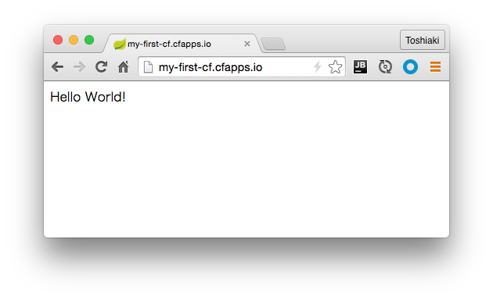

Slide 68
Database Access

Slide 69
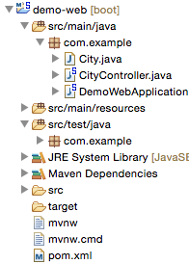
Add dependencies
Add
<dependency>
<groupId>org.springframework.boot</groupId>
<artifactId>spring-boot-starter-jdbc</artifactId>
</dependency>
<dependency>
<groupId>com.h2database</groupId>
<artifactId>h2</artifactId>
<scope>runtime</scope>
</dependency>

Slide 70
Use JdbcTemplate
@RestController
public class CityController {
@Autowired
JdbcTemplate jdbcTemplate;
@GetMapping("/cities")
List<City> getCities() {
return jdbcTemplate.query("SELECT id, name FROM city ORDER BY id", (rs, i) -> {
City city = new City();
city.setId(rs.getInt("id"));
city.setName(rs.getString("name"));
return city;
});
}
@PostMapping("/cities")
City postCities(@RequestBody City city) {
jdbcTemplate.update("INSERT INTO city(name) VALUES(?)", city.getName());
return city;
}
}

Slide 71
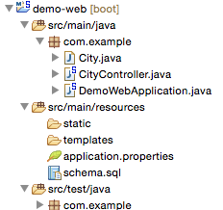
Create DDL file
Create schema.sql
CREATE TABLE city (
id INT PRIMARY KEY AUTO_INCREMENT,
name VARCHAR(255)
);

Slide 72
Re-Run & Access API (03-01)
. ____ _ __ _ _
/\\ / ___'_ __ _ _(_)_ __ __ _ \ \ \ \
( ( )\___ | '_ | '_| | '_ \/ _` | \ \ \ \
\\/ ___)| |_)| | | | | || (_| | ) ) ) )
' |____| .__|_| |_|_| |_\__, | / / / /
=========|_|==============|___/=/_/_/_/
:: Spring Boot :: (v1.5.1.RELEASE)
2017-02-07 11:11:16.290 INFO 1795 --- [ main] com.example.DemoWebApplication : Starting DemoWebApplication on jpxxmakitm1.corp.emc.com with PID 1795 (/Users/makit/git/getting-started-with-spring-boot/demo-web/target/classes started by makit in /Users/makit/git/getting-started-with-spring-boot/demo-web)
2017-02-07 11:11:16.294 INFO 1795 --- [ main] com.example.DemoWebApplication : No active profile set, falling back to default profiles: default
2017-02-07 11:11:16.351 INFO 1795 --- [ main] ationConfigEmbeddedWebApplicationContext : Refreshing org.springframework.boot.context.embedded.AnnotationConfigEmbeddedWebApplicationContext@3439f68d: startup date [Tue Feb 07 11:11:16 JST 2017]; root of context hierarchy
2017-02-07 11:11:17.162 INFO 1795 --- [ main] trationDelegate$BeanPostProcessorChecker : Bean 'org.springframework.boot.autoconfigure.validation.ValidationAutoConfiguration' of type [class org.springframework.boot.autoconfigure.validation.ValidationAutoConfiguration] is not eligible for getting processed by all BeanPostProcessors (for example: not eligible for auto-proxying)
2017-02-07 11:11:17.219 INFO 1795 --- [ main] trationDelegate$BeanPostProcessorChecker : Bean 'validator' of type [class org.springframework.validation.beanvalidation.LocalValidatorFactoryBean] is not eligible for getting processed by all BeanPostProcessors (for example: not eligible for auto-proxying)
2017-02-07 11:11:17.243 INFO 1795 --- [ main] trationDelegate$BeanPostProcessorChecker : Bean 'org.springframework.transaction.annotation.ProxyTransactionManagementConfiguration' of type [class org.springframework.transaction.annotation.ProxyTransactionManagementConfiguration$$EnhancerBySpringCGLIB$$1d099d1d] is not eligible for getting processed by all BeanPostProcessors (for example: not eligible for auto-proxying)
2017-02-07 11:11:17.500 INFO 1795 --- [ main] s.b.c.e.t.TomcatEmbeddedServletContainer : Tomcat initialized with port(s): 8080 (http)
2017-02-07 11:11:17.512 INFO 1795 --- [ main] o.apache.catalina.core.StandardService : Starting service Tomcat
2017-02-07 11:11:17.513 INFO 1795 --- [ main] org.apache.catalina.core.StandardEngine : Starting Servlet Engine: Apache Tomcat/8.5.11
2017-02-07 11:11:17.603 INFO 1795 --- [ost-startStop-1] o.a.c.c.C.[Tomcat].[localhost].[/] : Initializing Spring embedded WebApplicationContext
2017-02-07 11:11:17.604 INFO 1795 --- [ost-startStop-1] o.s.web.context.ContextLoader : Root WebApplicationContext: initialization completed in 1257 ms
2017-02-07 11:11:17.740 INFO 1795 --- [ost-startStop-1] o.s.b.w.servlet.ServletRegistrationBean : Mapping servlet: 'dispatcherServlet' to [/]
2017-02-07 11:11:17.744 INFO 1795 --- [ost-startStop-1] o.s.b.w.servlet.FilterRegistrationBean : Mapping filter: 'characterEncodingFilter' to: [/*]
2017-02-07 11:11:17.744 INFO 1795 --- [ost-startStop-1] o.s.b.w.servlet.FilterRegistrationBean : Mapping filter: 'hiddenHttpMethodFilter' to: [/*]
2017-02-07 11:11:17.744 INFO 1795 --- [ost-startStop-1] o.s.b.w.servlet.FilterRegistrationBean : Mapping filter: 'httpPutFormContentFilter' to: [/*]
2017-02-07 11:11:17.745 INFO 1795 --- [ost-startStop-1] o.s.b.w.servlet.FilterRegistrationBean : Mapping filter: 'requestContextFilter' to: [/*]
2017-02-07 11:11:18.182 INFO 1795 --- [ main] o.s.jdbc.datasource.init.ScriptUtils : Executing SQL script from URL [file:/Users/makit/git/getting-started-with-spring-boot/demo-web/target/classes/schema.sql]
2017-02-07 11:11:18.196 INFO 1795 --- [ main] o.s.jdbc.datasource.init.ScriptUtils : Executed SQL script from URL [file:/Users/makit/git/getting-started-with-spring-boot/demo-web/target/classes/schema.sql] in 14 ms.
2017-02-07 11:11:18.489 INFO 1795 --- [ main] s.w.s.m.m.a.RequestMappingHandlerAdapter : Looking for @ControllerAdvice: org.springframework.boot.context.embedded.AnnotationConfigEmbeddedWebApplicationContext@3439f68d: startup date [Tue Feb 07 11:11:16 JST 2017]; root of context hierarchy
2017-02-07 11:11:18.544 INFO 1795 --- [ main] s.w.s.m.m.a.RequestMappingHandlerMapping : Mapped "{[/],methods=[GET]}" onto java.lang.String com.example.DemoWebApplication.hello()
2017-02-07 11:11:18.547 INFO 1795 --- [ main] s.w.s.m.m.a.RequestMappingHandlerMapping : Mapped "{[/cities],methods=[GET]}" onto java.util.List<com.example.City> com.example.CityController.getCities()
2017-02-07 11:11:18.548 INFO 1795 --- [ main] s.w.s.m.m.a.RequestMappingHandlerMapping : Mapped "{[/cities],methods=[POST]}" onto com.example.City com.example.CityController.postCities(com.example.City)
2017-02-07 11:11:18.550 INFO 1795 --- [ main] s.w.s.m.m.a.RequestMappingHandlerMapping : Mapped "{[/error]}" onto public org.springframework.http.ResponseEntity<java.util.Map<java.lang.String, java.lang.Object>> org.springframework.boot.autoconfigure.web.BasicErrorController.error(javax.servlet.http.HttpServletRequest)
2017-02-07 11:11:18.551 INFO 1795 --- [ main] s.w.s.m.m.a.RequestMappingHandlerMapping : Mapped "{[/error],produces=[text/html]}" onto public org.springframework.web.servlet.ModelAndView org.springframework.boot.autoconfigure.web.BasicErrorController.errorHtml(javax.servlet.http.HttpServletRequest,javax.servlet.http.HttpServletResponse)
2017-02-07 11:11:18.575 INFO 1795 --- [ main] o.s.w.s.handler.SimpleUrlHandlerMapping : Mapped URL path [/webjars/**] onto handler of type [class org.springframework.web.servlet.resource.ResourceHttpRequestHandler]
2017-02-07 11:11:18.576 INFO 1795 --- [ main] o.s.w.s.handler.SimpleUrlHandlerMapping : Mapped URL path [/**] onto handler of type [class org.springframework.web.servlet.resource.ResourceHttpRequestHandler]
2017-02-07 11:11:18.612 INFO 1795 --- [ main] o.s.w.s.handler.SimpleUrlHandlerMapping : Mapped URL path [/**/favicon.ico] onto handler of type [class org.springframework.web.servlet.resource.ResourceHttpRequestHandler]
2017-02-07 11:11:18.817 INFO 1795 --- [ main] o.s.j.e.a.AnnotationMBeanExporter : Registering beans for JMX exposure on startup
2017-02-07 11:11:18.869 INFO 1795 --- [ main] s.b.c.e.t.TomcatEmbeddedServletContainer : Tomcat started on port(s): 8080 (http)
2017-02-07 11:11:18.876 INFO 1795 --- [ main] com.example.DemoWebApplication : Started DemoWebApplication in 2.848 seconds (JVM running for 3.143)

Slide 73
Re-Run & Access API (03-01)
$ curl -X GET http://localhost:8080/cities
[]
$ curl -X POST http://localhost:8080/cities -H "Content-Type: application/json" -d "{\"name\":\"Tokyo\"}"
{"id":null,"name":"Tokyo"}
$ curl -X POST http://localhost:8080/cities -H "Content-Type: application/json" -d "{\"name\":\"Osaka\"}"
{"id":null,"name":"Osaka"}
$ curl -X GET http://localhost:8080/cities
[{"id":1,"name":"Tokyo"},{"id":2,"name":"Osaka"}]

Slide 74
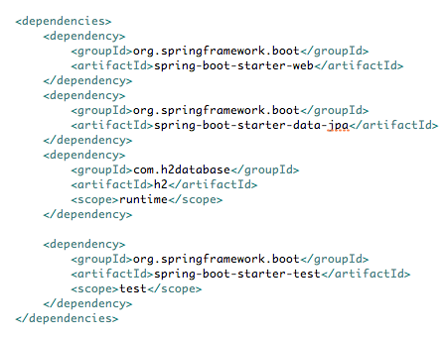
Use Spring Data JPA
<dependency>
<groupId>org.springframework.boot</groupId>
<artifactId>spring-boot-starter-data-jpa</artifactId>
</dependency>
Instead of
starter-jdbc

Slide 75
Create JPA's Entity
@Entity
public class City {
@Id
@GeneratedValue(strategy = GenerationType.IDENTITY)
private Integer id;
private String name;
public Integer getId() {
return id;
}
public void setId(Integer id) {
this.id = id;
}
public String getName() {
return name;
}
public void setName(String name) {
this.name = name;
}
}

Slide 76
Create Repository
package com.example;
import org.springframework.data.jpa.repository.JpaRepository;
public interface CityRepository extends JpaRepository<City, Integer> {
}

Slide 77
Use CityRepository
@RestController
public class CityController {
@Autowired
CityRepository cityRepository;
@GetMapping("/cities")
List<City> getCities() {
return cityRepository.findAll();
}
@PostMapping("/cities")
City postCities(@RequestBody City city) {
return cityRepository.save(city);
}
}

Slide 78
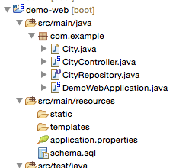
Remove DDL file
Remove schema.sql
JPA generates schema automatically

Slide 79
Re-Run (03-02)
. ____ _ __ _ _
/\\ / ___'_ __ _ _(_)_ __ __ _ \ \ \ \
( ( )\___ | '_ | '_| | '_ \/ _` | \ \ \ \
\\/ ___)| |_)| | | | | || (_| | ) ) ) )
' |____| .__|_| |_|_| |_\__, | / / / /
=========|_|==============|___/=/_/_/_/
:: Spring Boot :: (v1.5.1.RELEASE)
2017-02-07 11:17:25.290 INFO 2852 --- [ main] com.example.DemoWebApplication : Starting DemoWebApplication on jpxxmakitm1.corp.emc.com with PID 2852 (/Users/makit/git/getting-started-with-spring-boot/demo-web/target/classes started by makit in /Users/makit/git/getting-started-with-spring-boot/demo-web)
2017-02-07 11:17:25.295 INFO 2852 --- [ main] com.example.DemoWebApplication : No active profile set, falling back to default profiles: default
2017-02-07 11:17:25.353 INFO 2852 --- [ main] ationConfigEmbeddedWebApplicationContext : Refreshing org.springframework.boot.context.embedded.AnnotationConfigEmbeddedWebApplicationContext@1dd02175: startup date [Tue Feb 07 11:17:25 JST 2017]; root of context hierarchy
2017-02-07 11:17:26.410 INFO 2852 --- [ main] trationDelegate$BeanPostProcessorChecker : Bean 'org.springframework.boot.autoconfigure.validation.ValidationAutoConfiguration' of type [class org.springframework.boot.autoconfigure.validation.ValidationAutoConfiguration] is not eligible for getting processed by all BeanPostProcessors (for example: not eligible for auto-proxying)
2017-02-07 11:17:26.465 INFO 2852 --- [ main] trationDelegate$BeanPostProcessorChecker : Bean 'validator' of type [class org.springframework.validation.beanvalidation.LocalValidatorFactoryBean] is not eligible for getting processed by all BeanPostProcessors (for example: not eligible for auto-proxying)
2017-02-07 11:17:26.505 INFO 2852 --- [ main] trationDelegate$BeanPostProcessorChecker : Bean 'org.springframework.transaction.annotation.ProxyTransactionManagementConfiguration' of type [class org.springframework.transaction.annotation.ProxyTransactionManagementConfiguration$$EnhancerBySpringCGLIB$$fca28f54] is not eligible for getting processed by all BeanPostProcessors (for example: not eligible for auto-proxying)
2017-02-07 11:17:26.829 INFO 2852 --- [ main] s.b.c.e.t.TomcatEmbeddedServletContainer : Tomcat initialized with port(s): 8080 (http)
2017-02-07 11:17:26.844 INFO 2852 --- [ main] o.apache.catalina.core.StandardService : Starting service Tomcat
2017-02-07 11:17:26.846 INFO 2852 --- [ main] org.apache.catalina.core.StandardEngine : Starting Servlet Engine: Apache Tomcat/8.5.11
2017-02-07 11:17:26.975 INFO 2852 --- [ost-startStop-1] o.a.c.c.C.[Tomcat].[localhost].[/] : Initializing Spring embedded WebApplicationContext
2017-02-07 11:17:26.975 INFO 2852 --- [ost-startStop-1] o.s.web.context.ContextLoader : Root WebApplicationContext: initialization completed in 1625 ms
2017-02-07 11:17:27.163 INFO 2852 --- [ost-startStop-1] o.s.b.w.servlet.ServletRegistrationBean : Mapping servlet: 'dispatcherServlet' to [/]
2017-02-07 11:17:27.169 INFO 2852 --- [ost-startStop-1] o.s.b.w.servlet.FilterRegistrationBean : Mapping filter: 'characterEncodingFilter' to: [/*]
2017-02-07 11:17:27.170 INFO 2852 --- [ost-startStop-1] o.s.b.w.servlet.FilterRegistrationBean : Mapping filter: 'hiddenHttpMethodFilter' to: [/*]
2017-02-07 11:17:27.170 INFO 2852 --- [ost-startStop-1] o.s.b.w.servlet.FilterRegistrationBean : Mapping filter: 'httpPutFormContentFilter' to: [/*]
2017-02-07 11:17:27.170 INFO 2852 --- [ost-startStop-1] o.s.b.w.servlet.FilterRegistrationBean : Mapping filter: 'requestContextFilter' to: [/*]
2017-02-07 11:17:27.740 INFO 2852 --- [ main] j.LocalContainerEntityManagerFactoryBean : Building JPA container EntityManagerFactory for persistence unit 'default'
2017-02-07 11:17:27.761 INFO 2852 --- [ main] o.hibernate.jpa.internal.util.LogHelper : HHH000204: Processing PersistenceUnitInfo [
name: default
...]
2017-02-07 11:17:27.848 INFO 2852 --- [ main] org.hibernate.Version : HHH000412: Hibernate Core {5.0.11.Final}
2017-02-07 11:17:27.849 INFO 2852 --- [ main] org.hibernate.cfg.Environment : HHH000206: hibernate.properties not found
2017-02-07 11:17:27.852 INFO 2852 --- [ main] org.hibernate.cfg.Environment : HHH000021: Bytecode provider name : javassist
2017-02-07 11:17:27.909 INFO 2852 --- [ main] o.hibernate.annotations.common.Version : HCANN000001: Hibernate Commons Annotations {5.0.1.Final}
2017-02-07 11:17:28.002 INFO 2852 --- [ main] org.hibernate.dialect.Dialect : HHH000400: Using dialect: org.hibernate.dialect.H2Dialect
2017-02-07 11:17:28.459 INFO 2852 --- [ main] org.hibernate.tool.hbm2ddl.SchemaExport : HHH000227: Running hbm2ddl schema export
2017-02-07 11:17:28.468 INFO 2852 --- [ main] org.hibernate.tool.hbm2ddl.SchemaExport : HHH000230: Schema export complete
2017-02-07 11:17:28.498 INFO 2852 --- [ main] j.LocalContainerEntityManagerFactoryBean : Initialized JPA EntityManagerFactory for persistence unit 'default'
2017-02-07 11:17:29.000 INFO 2852 --- [ main] s.w.s.m.m.a.RequestMappingHandlerAdapter : Looking for @ControllerAdvice: org.springframework.boot.context.embedded.AnnotationConfigEmbeddedWebApplicationContext@1dd02175: startup date [Tue Feb 07 11:17:25 JST 2017]; root of context hierarchy
2017-02-07 11:17:29.082 INFO 2852 --- [ main] s.w.s.m.m.a.RequestMappingHandlerMapping : Mapped "{[/],methods=[GET]}" onto java.lang.String com.example.DemoWebApplication.hello()
2017-02-07 11:17:29.087 INFO 2852 --- [ main] s.w.s.m.m.a.RequestMappingHandlerMapping : Mapped "{[/cities],methods=[POST]}" onto com.example.City com.example.CityController.postCities(com.example.City)
2017-02-07 11:17:29.087 INFO 2852 --- [ main] s.w.s.m.m.a.RequestMappingHandlerMapping : Mapped "{[/cities],methods=[GET]}" onto java.util.List<com.example.City> com.example.CityController.getCities()
2017-02-07 11:17:29.090 INFO 2852 --- [ main] s.w.s.m.m.a.RequestMappingHandlerMapping : Mapped "{[/error]}" onto public org.springframework.http.ResponseEntity<java.util.Map<java.lang.String, java.lang.Object>> org.springframework.boot.autoconfigure.web.BasicErrorController.error(javax.servlet.http.HttpServletRequest)
2017-02-07 11:17:29.090 INFO 2852 --- [ main] s.w.s.m.m.a.RequestMappingHandlerMapping : Mapped "{[/error],produces=[text/html]}" onto public org.springframework.web.servlet.ModelAndView org.springframework.boot.autoconfigure.web.BasicErrorController.errorHtml(javax.servlet.http.HttpServletRequest,javax.servlet.http.HttpServletResponse)
2017-02-07 11:17:29.129 INFO 2852 --- [ main] o.s.w.s.handler.SimpleUrlHandlerMapping : Mapped URL path [/webjars/**] onto handler of type [class org.springframework.web.servlet.resource.ResourceHttpRequestHandler]
2017-02-07 11:17:29.129 INFO 2852 --- [ main] o.s.w.s.handler.SimpleUrlHandlerMapping : Mapped URL path [/**] onto handler of type [class org.springframework.web.servlet.resource.ResourceHttpRequestHandler]
2017-02-07 11:17:29.181 INFO 2852 --- [ main] o.s.w.s.handler.SimpleUrlHandlerMapping : Mapped URL path [/**/favicon.ico] onto handler of type [class org.springframework.web.servlet.resource.ResourceHttpRequestHandler]
2017-02-07 11:17:29.478 INFO 2852 --- [ main] o.s.j.e.a.AnnotationMBeanExporter : Registering beans for JMX exposure on startup
2017-02-07 11:17:29.545 INFO 2852 --- [ main] s.b.c.e.t.TomcatEmbeddedServletContainer : Tomcat started on port(s): 8080 (http)
2017-02-07 11:17:29.552 INFO 2852 --- [ main] com.example.DemoWebApplication : Started DemoWebApplication in 4.541 seconds (JVM running for 4.875)

Slide 80
Access API
$ curl -X GET http://localhost:8080/cities
[]
$ curl -X POST http://localhost:8080/cities -H "Content-Type: application/json" -d "{\"name\":\"Tokyo\"}"
{"id":1,"name":"Tokyo"}
$ curl -X POST http://localhost:8080/cities -H "Content-Type: application/json" -d "{\"name\":\"Osaka\"}"
{"id":2,"name":"Osaka"}
$ curl -X GET http://localhost:8080/cities
[{"id":1,"name":"Tokyo"},{"id":2,"name":"Osaka"}]

Slide 81
Push to Cloud Foundry with PostgreSQL
$ mvn clean package -Dmaven.test.skip=true
$ cf push my-second-cf -p target/demo-web-0.0.1-SNAPSHOT.jar --no-start
$ cf create-service elephantsql turtle demo-pg
$ cf bind-service my-second-cf demo-pg
$ cf set-env my-second-cf spring.jpa.hibernate.ddl-auto update
$ cf start my-second-cf

Slide 82
Push to Cloud Foundry with PostgreSQL
Starting app my-second-cf in org maki-org / space development as
...
Creating container
Successfully created container
Downloading app package...
Downloaded app package (23.3M)
Staging...
-----> Java Buildpack Version: v3.5.1 | http://github.com/pivotal-cf/pcf-java-buildpack.git#d6c19f8
-----> Downloading Open Jdk JRE 1.8.0_71 from https://download.run.pivotal.io/openjdk/trusty/x86_64/openjdk-1.8.0_71.tar.gz (1.0s)
Expanding Open Jdk JRE to .java-buildpack/open_jdk_jre (1.0s)
-----> Downloading Open JDK Like Memory Calculator 2.0.1_RELEASE from https://download.run.pivotal.io/memory-calculator/trusty/x86_64/memory-calculator-2.0.1_RELEASE.tar.gz (0.0s)
Memory Settings: -Xss1M -Xmx768M -XX:MaxMetaspaceSize=104857K -Xms768M -XX:MetaspaceSize=104857K
-----> Downloading Postgresql JDBC 9.4.1207 from https://download.run.pivotal.io/postgresql-jdbc/postgresql-jdbc-9.4.1207.jar (0.0s)
-----> Downloading Spring Auto Reconfiguration 1.10.0_RELEASE from https://download.run.pivotal.io/auto-reconfiguration/auto-reconfiguration-1.10.0_RELEASE.jar (0.0s)
Exit status 0
Staging complete
Uploading droplet, build artifacts cache...
Uploading droplet...
Uploading build artifacts cache...
Uploaded build artifacts cache (45.3M)
Uploaded droplet (68.8M)
Uploading complete

Slide 83
Push to Cloud Foundry with PostgreSQL
$ cf logs my-second-cf --recent
...
2016-02-03T17:34:59.78+0900 [APP/0] OUT . ____ _ __ _ _
2016-02-03T17:34:59.78+0900 [APP/0] OUT /\\ / ___'_ __ _ _(_)_ __ __ _ \ \ \ \
2016-02-03T17:34:59.78+0900 [APP/0] OUT ( ( )\___ | '_ | '_| | '_ \/ _` | \ \ \ \
2016-02-03T17:34:59.78+0900 [APP/0] OUT \\/ ___)| |_)| | | | | || (_| | ) ) ) )
2016-02-03T17:34:59.78+0900 [APP/0] OUT ' |____| .__|_| |_|_| |_\__, | / / / /
2016-02-03T17:34:59.78+0900 [APP/0] OUT =========|_|==============|___/=/_/_/_/
2016-02-03T17:34:59.78+0900 [APP/0] OUT :: Spring Boot :: (v1.3.2.RELEASE)
2016-02-03T17:34:59.97+0900 [APP/0] OUT 2016-02-03 08:34:59.969 INFO 17 --- [ main] pertySourceApplicationContextInitializer : Adding 'cloud' PropertySource to ApplicationContext
2016-02-03T17:35:00.04+0900 [APP/0] OUT 2016-02-03 08:35:00.048 INFO 17 --- [ main] nfigurationApplicationContextInitializer : Adding cloud service auto-reconfiguration to ApplicationContext
2016-02-03T17:35:00.06+0900 [APP/0] OUT 2016-02-03 08:35:00.062 INFO 17 --- [ main] com.example.DemoWebApplication : Starting DemoWebApplication on bqhqjki4du4 with PID 17 (/home/vcap/app started by vcap in /home/vcap/app)
2016-02-03T17:35:00.06+0900 [APP/0] OUT 2016-02-03 08:35:00.063 INFO 17 --- [ main] com.example.DemoWebApplication : The following profiles are active: cloud
2016-02-03T17:35:00.13+0900 [APP/0] OUT 2016-02-03 08:35:00.132 INFO 17 --- [ main] ationConfigEmbeddedWebApplicationContext : Refreshing org.springframework.boot.context.embedded.AnnotationConfigEmbeddedWebApplicationContext@5aff0582: startup date [Wed Feb 03 08:35:00 UTC 2016]; root of context hierarchy
2016-02-03T17:35:01.45+0900 [APP/0] OUT 2016-02-03 08:35:01.458 INFO 17 --- [ main] o.s.b.f.s.DefaultListableBeanFactory : Overriding bean definition for bean 'beanNameViewResolver' with a different definition: replacing [Root bean: class [null]; scope=; abstract=false; lazyInit=false; autowireMode=3; dependencyCheck=0; autowireCandidate=true; primary=false; factoryBeanName=org.springframework.boot.autoconfigure.web.ErrorMvcAutoConfiguration$WhitelabelErrorViewConfiguration; factoryMethodName=beanNameViewResolver; initMethodName=null; destroyMethodName=(inferred); defined in class path resource [org/springframework/boot/autoconfigure/web/ErrorMvcAutoConfiguration$WhitelabelErrorViewConfiguration.class]] with [Root bean: class [null]; scope=; abstract=false; lazyInit=false; autowireMode=3; dependencyCheck=0; autowireCandidate=true; primary=false; factoryBeanName=org.springframework.boot.autoconfigure.web.WebMvcAutoConfiguration$WebMvcAutoConfigurationAdapter; factoryMethodName=beanNameViewResolver; initMethodName=null; destroyMethodName=(inferred); defined in class path resource [org/springframework/boot/autoconfigure/web/WebMvcAutoConfiguration$WebMvcAutoConfigurationAdapter.class]]
2016-02-03T17:35:01.95+0900 [APP/0] OUT 2016-02-03 08:35:01.954 INFO 17 --- [ main] urceCloudServiceBeanFactoryPostProcessor : Auto-reconfiguring beans of type javax.sql.DataSource
2016-02-03T17:35:01.97+0900 [APP/0] OUT 2016-02-03 08:35:01.977 INFO 17 --- [ main] o.c.r.o.s.c.s.r.PooledDataSourceCreator : Found Tomcat high-performance connection pool on the classpath. Using it for DataSource connection pooling.
2016-02-03T17:35:02.02+0900 [APP/0] OUT 2016-02-03 08:35:02.017 INFO 17 --- [ main] urceCloudServiceBeanFactoryPostProcessor : Reconfigured bean dataSource into singleton service connector org.apache.tomcat.jdbc.pool.DataSource@5837583a{ConnectionPool[defaultAutoCommit=null; defaultReadOnly=null; defaultTransactionIsolation=-1; defaultCatalog=null; driverClassName=org.postgresql.Driver; maxActive=4; maxIdle=100; minIdle=0; initialSize=0; maxWait=30000; testOnBorrow=true; testOnReturn=false; timeBetweenEvictionRunsMillis=5000; numTestsPerEvictionRun=0; minEvictableIdleTimeMillis=60000; testWhileIdle=false; testOnConnect=false; password=********; url=jdbc:postgresql://pellefant-01.db.elephantsql.com:5432/qttknhee?user=qttknhee&password=3TPD1LUSPJF9PhxtRowA1kkn3gr0-dE3; username=null; validationQuery=SELECT 1; validationQueryTimeout=-1; validatorClassName=null; validationInterval=30000; accessToUnderlyingConnectionAllowed=true; removeAbandoned=false; removeAbandonedTimeout=60; logAbandoned=false; connectionProperties=null; initSQL=null; jdbcInterceptors=null; jmxEnabled=true; fairQueue=true; useEquals=true; abandonWhenPercentageFull=0; maxAge=0; useLock=false; dataSource=null; dataSourceJNDI=null; suspectTimeout=0; alternateUsernameAllowed=false; commitOnReturn=false; rollbackOnReturn=false; useDisposableConnectionFacade=true; logValidationErrors=false; propagateInterruptState=false; ignoreExceptionOnPreLoad=false; }
2016-02-03T17:35:02.02+0900 [APP/0] OUT 2016-02-03 08:35:02.020 INFO 17 --- [ main] nateCloudServiceBeanFactoryPostProcessor : Auto-reconfiguring beans of type org.springframework.orm.hibernate3.AbstractSessionFactoryBean
2016-02-03T17:35:02.02+0900 [APP/0] OUT 2016-02-03 08:35:02.022 INFO 17 --- [ main] nateCloudServiceBeanFactoryPostProcessor : Auto-reconfiguring beans of type org.springframework.orm.hibernate4.LocalSessionFactoryBean
2016-02-03T17:35:02.02+0900 [APP/0] OUT 2016-02-03 08:35:02.023 INFO 17 --- [ main] .JpaCloudServiceBeanFactoryPostProcessor : Auto-reconfiguring beans of type org.springframework.orm.jpa.AbstractEntityManagerFactoryBean
2016-02-03T17:35:02.20+0900 [APP/0] OUT 2016-02-03 08:35:02.204 INFO 17 --- [ main] trationDelegate$BeanPostProcessorChecker : Bean 'org.springframework.transaction.annotation.ProxyTransactionManagementConfiguration' of type [class org.springframework.transaction.annotation.ProxyTransactionManagementConfiguration$$EnhancerBySpringCGLIB$$15ea5add] is not eligible for getting processed by all BeanPostProcessors (for example: not eligible for auto-proxying)
2016-02-03T17:35:02.94+0900 [APP/0] OUT 2016-02-03 08:35:02.944 INFO 17 --- [ main] s.b.c.e.t.TomcatEmbeddedServletContainer : Tomcat initialized with port(s): 8080 (http)
2016-02-03T17:35:02.96+0900 [APP/0] OUT 2016-02-03 08:35:02.963 INFO 17 --- [ main] o.apache.catalina.core.StandardService : Starting service Tomcat
2016-02-03T17:35:02.96+0900 [APP/0] OUT 2016-02-03 08:35:02.965 INFO 17 --- [ main] org.apache.catalina.core.StandardEngine : Starting Servlet Engine: Apache Tomcat/8.0.30
2016-02-03T17:35:03.12+0900 [APP/0] OUT 2016-02-03 08:35:03.127 INFO 17 --- [ost-startStop-1] o.a.c.c.C.[Tomcat].[localhost].[/] : Initializing Spring embedded WebApplicationContext
2016-02-03T17:35:03.12+0900 [APP/0] OUT 2016-02-03 08:35:03.128 INFO 17 --- [ost-startStop-1] o.s.web.context.ContextLoader : Root WebApplicationContext: initialization completed in 3000 ms
2016-02-03T17:35:03.82+0900 [APP/0] OUT 2016-02-03 08:35:03.820 INFO 17 --- [ost-startStop-1] o.s.b.c.e.ServletRegistrationBean : Mapping servlet: 'dispatcherServlet' to [/]
2016-02-03T17:35:03.82+0900 [APP/0] OUT 2016-02-03 08:35:03.827 INFO 17 --- [ost-startStop-1] o.s.b.c.embedded.FilterRegistrationBean : Mapping filter: 'characterEncodingFilter' to: [/*]
2016-02-03T17:35:03.82+0900 [APP/0] OUT 2016-02-03 08:35:03.828 INFO 17 --- [ost-startStop-1] o.s.b.c.embedded.FilterRegistrationBean : Mapping filter: 'hiddenHttpMethodFilter' to: [/*]
2016-02-03T17:35:03.82+0900 [APP/0] OUT 2016-02-03 08:35:03.828 INFO 17 --- [ost-startStop-1] o.s.b.c.embedded.FilterRegistrationBean : Mapping filter: 'httpPutFormContentFilter' to: [/*]
2016-02-03T17:35:03.82+0900 [APP/0] OUT 2016-02-03 08:35:03.828 INFO 17 --- [ost-startStop-1] o.s.b.c.embedded.FilterRegistrationBean : Mapping filter: 'requestContextFilter' to: [/*]
2016-02-03T17:35:03.96+0900 [APP/0] OUT 2016-02-03 08:35:03.964 INFO 17 --- [ main] j.LocalContainerEntityManagerFactoryBean : Building JPA container EntityManagerFactory for persistence unit 'default'
2016-02-03T17:35:03.98+0900 [APP/0] OUT 2016-02-03 08:35:03.978 INFO 17 --- [ main] o.hibernate.jpa.internal.util.LogHelper : HHH000204: Processing PersistenceUnitInfo [
2016-02-03T17:35:03.98+0900 [APP/0] OUT name: default
2016-02-03T17:35:03.98+0900 [APP/0] OUT ...]
2016-02-03T17:35:04.15+0900 [APP/0] OUT 2016-02-03 08:35:04.154 INFO 17 --- [ main] org.hibernate.Version : HHH000412: Hibernate Core {4.3.11.Final}
2016-02-03T17:35:04.15+0900 [APP/0] OUT 2016-02-03 08:35:04.157 INFO 17 --- [ main] org.hibernate.cfg.Environment : HHH000206: hibernate.properties not found
2016-02-03T17:35:04.16+0900 [APP/0] OUT 2016-02-03 08:35:04.159 INFO 17 --- [ main] org.hibernate.cfg.Environment : HHH000021: Bytecode provider name : javassist
2016-02-03T17:35:04.51+0900 [APP/0] OUT 2016-02-03 08:35:04.510 INFO 17 --- [ main] o.hibernate.annotations.common.Version : HCANN000001: Hibernate Commons Annotations {4.0.5.Final}
2016-02-03T17:35:05.48+0900 [APP/0] OUT 2016-02-03 08:35:05.485 INFO 17 --- [ main] org.hibernate.dialect.Dialect : HHH000400: Using dialect: org.hibernate.dialect.PostgreSQLDialect
2016-02-03T17:35:05.50+0900 [APP/0] OUT 2016-02-03 08:35:05.508 INFO 17 --- [ main] o.h.e.jdbc.internal.LobCreatorBuilder : HHH000424: Disabling contextual LOB creation as createClob() method threw error : java.lang.reflect.InvocationTargetException
2016-02-03T17:35:05.66+0900 [APP/0] OUT 2016-02-03 08:35:05.662 INFO 17 --- [ main] o.h.h.i.ast.ASTQueryTranslatorFactory : HHH000397: Using ASTQueryTranslatorFactory
2016-02-03T17:35:05.99+0900 [APP/0] OUT 2016-02-03 08:35:05.990 INFO 17 --- [ main] org.hibernate.tool.hbm2ddl.SchemaUpdate : HHH000228: Running hbm2ddl schema update
2016-02-03T17:35:05.99+0900 [APP/0] OUT 2016-02-03 08:35:05.990 INFO 17 --- [ main] org.hibernate.tool.hbm2ddl.SchemaUpdate : HHH000102: Fetching database metadata
2016-02-03T17:35:05.99+0900 [APP/0] OUT 2016-02-03 08:35:05.996 INFO 17 --- [ main] org.hibernate.tool.hbm2ddl.SchemaUpdate : HHH000396: Updating schema
2016-02-03T17:35:06.00+0900 [APP/0] OUT 2016-02-03 08:35:06.007 INFO 17 --- [ main] java.sql.DatabaseMetaData : HHH000262: Table not found: city
2016-02-03T17:35:06.01+0900 [APP/0] OUT 2016-02-03 08:35:06.010 INFO 17 --- [ main] java.sql.DatabaseMetaData : HHH000262: Table not found: city
2016-02-03T17:35:06.01+0900 [APP/0] OUT 2016-02-03 08:35:06.012 INFO 17 --- [ main] java.sql.DatabaseMetaData : HHH000262: Table not found: city
2016-02-03T17:35:06.08+0900 [APP/0] OUT 2016-02-03 08:35:06.081 INFO 17 --- [ main] org.hibernate.tool.hbm2ddl.SchemaUpdate : HHH000232: Schema update complete
2016-02-03T17:35:06.72+0900 [APP/0] OUT 2016-02-03 08:35:06.725 INFO 17 --- [ main] s.w.s.m.m.a.RequestMappingHandlerAdapter : Looking for @ControllerAdvice: org.springframework.boot.context.embedded.AnnotationConfigEmbeddedWebApplicationContext@5aff0582: startup date [Wed Feb 03 08:35:00 UTC 2016]; root of context hierarchy
2016-02-03T17:35:06.83+0900 [APP/0] OUT 2016-02-03 08:35:06.833 INFO 17 --- [ main] s.w.s.m.m.a.RequestMappingHandlerMapping : Mapped "{[/]}" onto java.lang.String com.example.DemoWebApplication.hello()
2016-02-03T17:35:06.83+0900 [APP/0] OUT 2016-02-03 08:35:06.835 INFO 17 --- [ main] s.w.s.m.m.a.RequestMappingHandlerMapping : Mapped "{[/cities],methods=[GET]}" onto java.util.List<com.example.City> com.example.CityController.getCities()
2016-02-03T17:35:06.83+0900 [APP/0] OUT 2016-02-03 08:35:06.836 INFO 17 --- [ main] s.w.s.m.m.a.RequestMappingHandlerMapping : Mapped "{[/cities],methods=[POST]}" onto com.example.City com.example.CityController.postCities(com.example.City)
2016-02-03T17:35:06.83+0900 [APP/0] OUT 2016-02-03 08:35:06.839 INFO 17 --- [ main] s.w.s.m.m.a.RequestMappingHandlerMapping : Mapped "{[/error],produces=[text/html]}" onto public org.springframework.web.servlet.ModelAndView org.springframework.boot.autoconfigure.web.BasicErrorController.errorHtml(javax.servlet.http.HttpServletRequest,javax.servlet.http.HttpServletResponse)
2016-02-03T17:35:06.83+0900 [APP/0] OUT 2016-02-03 08:35:06.839 INFO 17 --- [ main] s.w.s.m.m.a.RequestMappingHandlerMapping : Mapped "{[/error]}" onto public org.springframework.http.ResponseEntity<java.util.Map<java.lang.String, java.lang.Object>> org.springframework.boot.autoconfigure.web.BasicErrorController.error(javax.servlet.http.HttpServletRequest)
2016-02-03T17:35:06.93+0900 [APP/0] OUT 2016-02-03 08:35:06.937 INFO 17 --- [ main] o.s.w.s.handler.SimpleUrlHandlerMapping : Mapped URL path [/webjars/**] onto handler of type [class org.springframework.web.servlet.resource.ResourceHttpRequestHandler]
2016-02-03T17:35:06.93+0900 [APP/0] OUT 2016-02-03 08:35:06.937 INFO 17 --- [ main] o.s.w.s.handler.SimpleUrlHandlerMapping : Mapped URL path [/**] onto handler of type [class org.springframework.web.servlet.resource.ResourceHttpRequestHandler]
2016-02-03T17:35:07.01+0900 [APP/0] OUT 2016-02-03 08:35:07.010 INFO 17 --- [ main] o.s.w.s.handler.SimpleUrlHandlerMapping : Mapped URL path [/**/favicon.ico] onto handler of type [class org.springframework.web.servlet.resource.ResourceHttpRequestHandler]
2016-02-03T17:35:07.42+0900 [APP/0] OUT 2016-02-03 08:35:07.420 INFO 17 --- [ main] o.s.j.e.a.AnnotationMBeanExporter : Registering beans for JMX exposure on startup
2016-02-03T17:35:07.50+0900 [CELL/0] OUT Container became healthy
2016-02-03T17:35:07.52+0900 [APP/0] OUT 2016-02-03 08:35:07.521 INFO 17 --- [ main] s.b.c.e.t.TomcatEmbeddedServletContainer : Tomcat started on port(s): 8080 (http)
2016-02-03T17:35:07.55+0900 [APP/0] OUT 2016-02-03 08:35:07.551 INFO 17 --- [ main] com.example.DemoWebApplication : Started DemoWebApplication in 8.646 seconds (JVM running for 9.327)

Slide 84
Access API
$ curl -X GET http://my-second-cf.cfapps.io/cities
[]
$ curl -X POST http://my-second-cf.cfapps.io/cities -H "Content-Type: application/json" -d "{\"name\":\"Tokyo\"}"
{"id":1,"name":"Tokyo"}
$ curl -X POST http://my-second-cf.cfapps.io/cities -H "Content-Type: application/json" -d "{\"name\":\"Osaka\"}"
{"id":2,"name":"Osaka"}
$ curl -X GET http://my-second-cf.cfapps.io/cities
[{"id":1,"name":"Tokyo"},{"id":2,"name":"Osaka"}]

Slide 85
Want to use schema.sql?
Disable JPA to generate schema
spring.jpa.hibernate.ddl-auto=none
# or validate
Use own schema.sql

Slide 86
Re-Run (03-03)
. ____ _ __ _ _
/\\ / ___'_ __ _ _(_)_ __ __ _ \ \ \ \
( ( )\___ | '_ | '_| | '_ \/ _` | \ \ \ \
\\/ ___)| |_)| | | | | || (_| | ) ) ) )
' |____| .__|_| |_|_| |_\__, | / / / /
=========|_|==============|___/=/_/_/_/
:: Spring Boot :: (v1.5.1.RELEASE)
2017-02-07 11:23:40.730 INFO 4086 --- [ main] com.example.DemoWebApplication : Starting DemoWebApplication on jpxxmakitm1.corp.emc.com with PID 4086 (/Users/makit/git/getting-started-with-spring-boot/demo-web/target/classes started by makit in /Users/makit/git/getting-started-with-spring-boot/demo-web)
2017-02-07 11:23:40.735 INFO 4086 --- [ main] com.example.DemoWebApplication : No active profile set, falling back to default profiles: default
2017-02-07 11:23:40.844 INFO 4086 --- [ main] ationConfigEmbeddedWebApplicationContext : Refreshing org.springframework.boot.context.embedded.AnnotationConfigEmbeddedWebApplicationContext@6a79c292: startup date [Tue Feb 07 11:23:40 JST 2017]; root of context hierarchy
2017-02-07 11:23:42.150 INFO 4086 --- [ main] trationDelegate$BeanPostProcessorChecker : Bean 'org.springframework.boot.autoconfigure.validation.ValidationAutoConfiguration' of type [class org.springframework.boot.autoconfigure.validation.ValidationAutoConfiguration] is not eligible for getting processed by all BeanPostProcessors (for example: not eligible for auto-proxying)
2017-02-07 11:23:42.231 INFO 4086 --- [ main] trationDelegate$BeanPostProcessorChecker : Bean 'validator' of type [class org.springframework.validation.beanvalidation.LocalValidatorFactoryBean] is not eligible for getting processed by all BeanPostProcessors (for example: not eligible for auto-proxying)
2017-02-07 11:23:42.295 INFO 4086 --- [ main] trationDelegate$BeanPostProcessorChecker : Bean 'org.springframework.transaction.annotation.ProxyTransactionManagementConfiguration' of type [class org.springframework.transaction.annotation.ProxyTransactionManagementConfiguration$$EnhancerBySpringCGLIB$$d061fcc9] is not eligible for getting processed by all BeanPostProcessors (for example: not eligible for auto-proxying)
2017-02-07 11:23:42.710 INFO 4086 --- [ main] s.b.c.e.t.TomcatEmbeddedServletContainer : Tomcat initialized with port(s): 8080 (http)
2017-02-07 11:23:42.728 INFO 4086 --- [ main] o.apache.catalina.core.StandardService : Starting service Tomcat
2017-02-07 11:23:42.729 INFO 4086 --- [ main] org.apache.catalina.core.StandardEngine : Starting Servlet Engine: Apache Tomcat/8.5.11
2017-02-07 11:23:42.879 INFO 4086 --- [ost-startStop-1] o.a.c.c.C.[Tomcat].[localhost].[/] : Initializing Spring embedded WebApplicationContext
2017-02-07 11:23:42.879 INFO 4086 --- [ost-startStop-1] o.s.web.context.ContextLoader : Root WebApplicationContext: initialization completed in 2043 ms
2017-02-07 11:23:43.084 INFO 4086 --- [ost-startStop-1] o.s.b.w.servlet.ServletRegistrationBean : Mapping servlet: 'dispatcherServlet' to [/]
2017-02-07 11:23:43.091 INFO 4086 --- [ost-startStop-1] o.s.b.w.servlet.FilterRegistrationBean : Mapping filter: 'characterEncodingFilter' to: [/*]
2017-02-07 11:23:43.092 INFO 4086 --- [ost-startStop-1] o.s.b.w.servlet.FilterRegistrationBean : Mapping filter: 'hiddenHttpMethodFilter' to: [/*]
2017-02-07 11:23:43.092 INFO 4086 --- [ost-startStop-1] o.s.b.w.servlet.FilterRegistrationBean : Mapping filter: 'httpPutFormContentFilter' to: [/*]
2017-02-07 11:23:43.093 INFO 4086 --- [ost-startStop-1] o.s.b.w.servlet.FilterRegistrationBean : Mapping filter: 'requestContextFilter' to: [/*]
2017-02-07 11:23:43.687 INFO 4086 --- [ main] o.s.jdbc.datasource.init.ScriptUtils : Executing SQL script from URL [file:/Users/makit/git/getting-started-with-spring-boot/demo-web/target/classes/schema.sql]
2017-02-07 11:23:43.702 INFO 4086 --- [ main] o.s.jdbc.datasource.init.ScriptUtils : Executed SQL script from URL [file:/Users/makit/git/getting-started-with-spring-boot/demo-web/target/classes/schema.sql] in 14 ms.
2017-02-07 11:23:43.874 INFO 4086 --- [ main] j.LocalContainerEntityManagerFactoryBean : Building JPA container EntityManagerFactory for persistence unit 'default'
2017-02-07 11:23:43.903 INFO 4086 --- [ main] o.hibernate.jpa.internal.util.LogHelper : HHH000204: Processing PersistenceUnitInfo [
name: default
...]
2017-02-07 11:23:44.010 INFO 4086 --- [ main] org.hibernate.Version : HHH000412: Hibernate Core {5.0.11.Final}
2017-02-07 11:23:44.012 INFO 4086 --- [ main] org.hibernate.cfg.Environment : HHH000206: hibernate.properties not found
2017-02-07 11:23:44.014 INFO 4086 --- [ main] org.hibernate.cfg.Environment : HHH000021: Bytecode provider name : javassist
2017-02-07 11:23:44.076 INFO 4086 --- [ main] o.hibernate.annotations.common.Version : HCANN000001: Hibernate Commons Annotations {5.0.1.Final}
2017-02-07 11:23:44.214 INFO 4086 --- [ main] org.hibernate.dialect.Dialect : HHH000400: Using dialect: org.hibernate.dialect.H2Dialect
2017-02-07 11:23:44.883 INFO 4086 --- [ main] j.LocalContainerEntityManagerFactoryBean : Initialized JPA EntityManagerFactory for persistence unit 'default'
2017-02-07 11:23:45.518 INFO 4086 --- [ main] s.w.s.m.m.a.RequestMappingHandlerAdapter : Looking for @ControllerAdvice: org.springframework.boot.context.embedded.AnnotationConfigEmbeddedWebApplicationContext@6a79c292: startup date [Tue Feb 07 11:23:40 JST 2017]; root of context hierarchy
2017-02-07 11:23:45.632 INFO 4086 --- [ main] s.w.s.m.m.a.RequestMappingHandlerMapping : Mapped "{[/],methods=[GET]}" onto java.lang.String com.example.DemoWebApplication.hello()
2017-02-07 11:23:45.637 INFO 4086 --- [ main] s.w.s.m.m.a.RequestMappingHandlerMapping : Mapped "{[/cities],methods=[GET]}" onto java.util.List<com.example.City> com.example.CityController.getCities()
2017-02-07 11:23:45.638 INFO 4086 --- [ main] s.w.s.m.m.a.RequestMappingHandlerMapping : Mapped "{[/cities],methods=[POST]}" onto com.example.City com.example.CityController.postCities(com.example.City)
2017-02-07 11:23:45.644 INFO 4086 --- [ main] s.w.s.m.m.a.RequestMappingHandlerMapping : Mapped "{[/error]}" onto public org.springframework.http.ResponseEntity<java.util.Map<java.lang.String, java.lang.Object>> org.springframework.boot.autoconfigure.web.BasicErrorController.error(javax.servlet.http.HttpServletRequest)
2017-02-07 11:23:45.645 INFO 4086 --- [ main] s.w.s.m.m.a.RequestMappingHandlerMapping : Mapped "{[/error],produces=[text/html]}" onto public org.springframework.web.servlet.ModelAndView org.springframework.boot.autoconfigure.web.BasicErrorController.errorHtml(javax.servlet.http.HttpServletRequest,javax.servlet.http.HttpServletResponse)
2017-02-07 11:23:45.701 INFO 4086 --- [ main] o.s.w.s.handler.SimpleUrlHandlerMapping : Mapped URL path [/webjars/**] onto handler of type [class org.springframework.web.servlet.resource.ResourceHttpRequestHandler]
2017-02-07 11:23:45.701 INFO 4086 --- [ main] o.s.w.s.handler.SimpleUrlHandlerMapping : Mapped URL path [/**] onto handler of type [class org.springframework.web.servlet.resource.ResourceHttpRequestHandler]
2017-02-07 11:23:45.765 INFO 4086 --- [ main] o.s.w.s.handler.SimpleUrlHandlerMapping : Mapped URL path [/**/favicon.ico] onto handler of type [class org.springframework.web.servlet.resource.ResourceHttpRequestHandler]
2017-02-07 11:23:46.156 INFO 4086 --- [ main] o.s.j.e.a.AnnotationMBeanExporter : Registering beans for JMX exposure on startup
2017-02-07 11:23:46.253 INFO 4086 --- [ main] s.b.c.e.t.TomcatEmbeddedServletContainer : Tomcat started on port(s): 8080 (http)
2017-02-07 11:23:46.261 INFO 4086 --- [ main] com.example.DemoWebApplication : Started DemoWebApplication in 5.895 seconds (JVM running for 6.313)

Slide 87
Access API
$ curl -X GET http://localhost:8080/cities
[]
$ curl -X POST http://localhost:8080/cities -H "Content-Type: application/json" -d "{\"name\":\"Tokyo\"}"
{"id":1,"name":"Tokyo"}
$ curl -X POST http://localhost:8080/cities -H "Content-Type: application/json" -d "{\"name\":\"Osaka\"}"
{"id":2,"name":"Osaka"}
$ curl -X GET http://localhost:8080/cities
[{"id":1,"name":"Tokyo"},{"id":2,"name":"Osaka"}]

Slide 88
Add Spring Data REST
<dependency>
<groupId>org.springframework.boot</groupId>
<artifactId>spring-boot-starter-data-rest</artifactId>
</dependency>

Slide 89
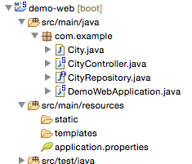
Delete CityController
No longer needed

Slide 90
Re-Run (03-04)
...
2017-02-07 11:29:21.832 INFO 5046 --- [ main] o.s.d.r.w.RepositoryRestHandlerMapping : Mapped "{[/{repository}],methods=[GET],produces=[application/hal+json || application/json || application/*+json;charset=UTF-8]}" onto public org.springframework.hateoas.Resources<?> org.springframework.data.rest.webmvc.RepositoryEntityController.getCollectionResource(org.springframework.data.rest.webmvc.RootResourceInformation,org.springframework.data.rest.webmvc.support.DefaultedPageable,org.springframework.data.domain.Sort,org.springframework.data.rest.webmvc.PersistentEntityResourceAssembler) throws org.springframework.data.rest.webmvc.ResourceNotFoundException,org.springframework.web.HttpRequestMethodNotSupportedException
2017-02-07 11:29:21.833 INFO 5046 --- [ main] o.s.d.r.w.RepositoryRestHandlerMapping : Mapped "{[/{repository}],methods=[GET],produces=[application/x-spring-data-compact+json || text/uri-list]}" onto public org.springframework.hateoas.Resources<?> org.springframework.data.rest.webmvc.RepositoryEntityController.getCollectionResourceCompact(org.springframework.data.rest.webmvc.RootResourceInformation,org.springframework.data.rest.webmvc.support.DefaultedPageable,org.springframework.data.domain.Sort,org.springframework.data.rest.webmvc.PersistentEntityResourceAssembler) throws org.springframework.data.rest.webmvc.ResourceNotFoundException,org.springframework.web.HttpRequestMethodNotSupportedException
2017-02-07 11:29:21.833 INFO 5046 --- [ main] o.s.d.r.w.RepositoryRestHandlerMapping : Mapped "{[/{repository}],methods=[POST],produces=[application/hal+json || application/json || application/*+json;charset=UTF-8]}" onto public org.springframework.http.ResponseEntity<org.springframework.hateoas.ResourceSupport> org.springframework.data.rest.webmvc.RepositoryEntityController.postCollectionResource(org.springframework.data.rest.webmvc.RootResourceInformation,org.springframework.data.rest.webmvc.PersistentEntityResource,org.springframework.data.rest.webmvc.PersistentEntityResourceAssembler,java.lang.String) throws org.springframework.web.HttpRequestMethodNotSupportedException
...

Slide 91
Spring Boot Actuator

Slide 92
Add Spring Boot Actuator
<dependency>
<groupId>org.springframework.boot</groupId>
<artifactId>spring-boot-starter-actuator</artifactId>
</dependency>

Slide 93
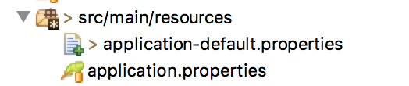
Create new properties
management.security.enabled=false

Slide 94
Re-Run
2016-02-04 15:32:14.330 INFO 54226 --- [ main] o.s.b.a.e.mvc.EndpointHandlerMapping : Mapped "{[/metrics/{name:.*}],methods=[GET],produces=[application/json]}" onto public java.lang.Object org.springframework.boot.actuate.endpoint.mvc.MetricsMvcEndpoint.value(java.lang.String)
2016-02-04 15:32:14.330 INFO 54226 --- [ main] o.s.b.a.e.mvc.EndpointHandlerMapping : Mapped "{[/metrics || /metrics.json],methods=[GET],produces=[application/json]}" onto public java.lang.Object org.springframework.boot.actuate.endpoint.mvc.EndpointMvcAdapter.invoke()
2016-02-04 15:32:14.331 INFO 54226 --- [ main] o.s.b.a.e.mvc.EndpointHandlerMapping : Mapped "{[/beans || /beans.json],methods=[GET],produces=[application/json]}" onto public java.lang.Object org.springframework.boot.actuate.endpoint.mvc.EndpointMvcAdapter.invoke()
2016-02-04 15:32:14.331 INFO 54226 --- [ main] o.s.b.a.e.mvc.EndpointHandlerMapping : Mapped "{[/trace || /trace.json],methods=[GET],produces=[application/json]}" onto public java.lang.Object org.springframework.boot.actuate.endpoint.mvc.EndpointMvcAdapter.invoke()
2016-02-04 15:32:14.332 INFO 54226 --- [ main] o.s.b.a.e.mvc.EndpointHandlerMapping : Mapped "{[/health || /health.json],produces=[application/json]}" onto public java.lang.Object org.springframework.boot.actuate.endpoint.mvc.HealthMvcEndpoint.invoke(java.security.Principal)
2016-02-04 15:32:14.332 INFO 54226 --- [ main] o.s.b.a.e.mvc.EndpointHandlerMapping : Mapped "{[/info || /info.json],methods=[GET],produces=[application/json]}" onto public java.lang.Object org.springframework.boot.actuate.endpoint.mvc.EndpointMvcAdapter.invoke()
2016-02-04 15:32:14.333 INFO 54226 --- [ main] o.s.b.a.e.mvc.EndpointHandlerMapping : Mapped "{[/autoconfig || /autoconfig.json],methods=[GET],produces=[application/json]}" onto public java.lang.Object org.springframework.boot.actuate.endpoint.mvc.EndpointMvcAdapter.invoke()
2016-02-04 15:32:14.333 INFO 54226 --- [ main] o.s.b.a.e.mvc.EndpointHandlerMapping : Mapped "{[/env/{name:.*}],methods=[GET],produces=[application/json]}" onto public java.lang.Object org.springframework.boot.actuate.endpoint.mvc.EnvironmentMvcEndpoint.value(java.lang.String)
2016-02-04 15:32:14.334 INFO 54226 --- [ main] o.s.b.a.e.mvc.EndpointHandlerMapping : Mapped "{[/env || /env.json],methods=[GET],produces=[application/json]}" onto public java.lang.Object org.springframework.boot.actuate.endpoint.mvc.EndpointMvcAdapter.invoke()
2016-02-04 15:32:14.334 INFO 54226 --- [ main] o.s.b.a.e.mvc.EndpointHandlerMapping : Mapped "{[/actuator || /actuator.json],produces=[application/json]}" onto public org.springframework.hateoas.ResourceSupport org.springframework.boot.actuate.endpoint.mvc.HalJsonMvcEndpoint.links()
2016-02-04 15:32:14.334 INFO 54226 --- [ main] o.s.b.a.e.mvc.EndpointHandlerMapping : Mapped "{[/dump || /dump.json],methods=[GET],produces=[application/json]}" onto public java.lang.Object org.springframework.boot.actuate.endpoint.mvc.EndpointMvcAdapter.invoke()
2016-02-04 15:32:14.335 INFO 54226 --- [ main] o.s.b.a.e.mvc.EndpointHandlerMapping : Mapped "{[/configprops || /configprops.json],methods=[GET],produces=[application/json]}" onto public java.lang.Object org.springframework.boot.actuate.endpoint.mvc.EndpointMvcAdapter.invoke()
2016-02-04 15:32:14.335 INFO 54226 --- [ main] o.s.b.a.e.mvc.EndpointHandlerMapping : Mapped "{[/mappings || /mappings.json],methods=[GET],produces=[application/json]}" onto public java.lang.Object org.springframework.boot.actuate.endpoint.mvc.EndpointMvcAdapter.invoke()

Slide 95
Push to Cloud Foundr
$ mvn clean package -Dmaven.test.skip=true
$ cf push my-second-cf -p target/demo-web-0.0.1-SNAPSHOT.jar

